Slide 1
Catholic Sustainability Champions June 23, 2021
CatholicClimateCovenant.org

Slide 2
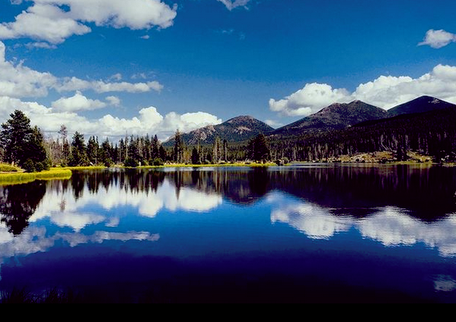
In Solidarity with All Creation Oh how beautiful are your ways, O God, the works of your creation. Raise our consciousness to know and feel deeply in our hearts our connectedness to all that is.
Instill in us the gift of being co-creators and sustainers of life. Teach us new and unsuspected ways of living so that current and future generations can walk humbly in beauty, love all compassionately, and live justly in solidarity with all creation.
Loving and gracious God, give us the courage to seek this transformation of self and society and the strength to see it through. Amen
~School Sisters of Notre Dame Green Team

Slide 3
Catholic Sustainability Champions
The webinar is being recorded and will a link to the recording will be sent to everyone who registered within the next 24-48 hours.
2) Please type your questions in the Q/A box

Slide 4
Catholic Sustainability Champions
https://www.creighton.edu/catholicclimate/
https://laudatosiactionplatform.org/

Slide 5
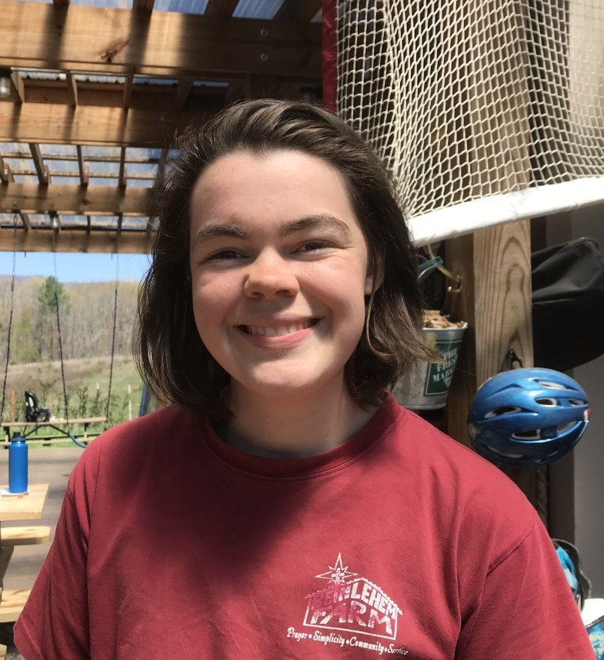
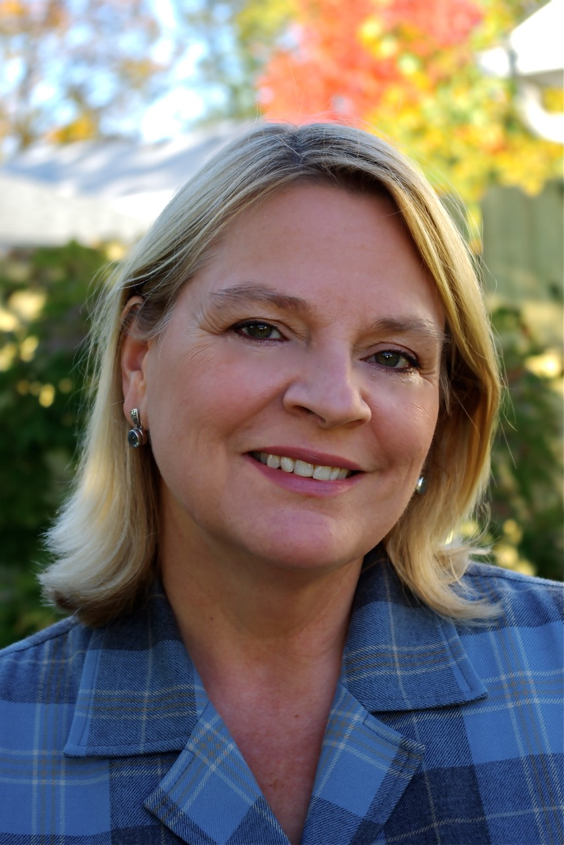
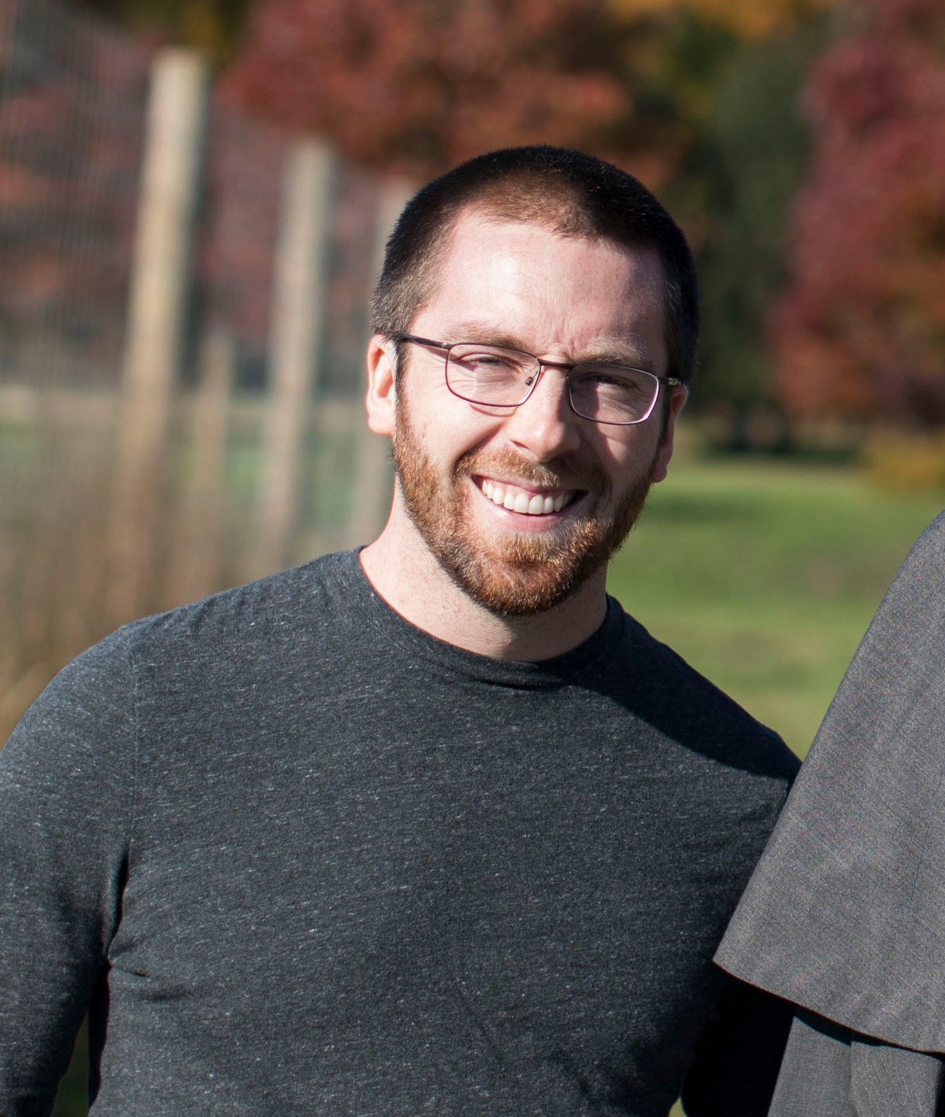
Catholic Sustainability Champions
Matt Jones Little Portion Farm
Molly Sutter Bethlehem Farm
Lorrie Heber White Violet Center for Eco-Justice
Moderator: Paz Artaza-Regan, Catholic Climate Covenant

Slide 6
White Violet Center for Eco-Justice A ministry of the Sisters of Providence at Saint Mary-of-the-Woods
Catholic Climate Covenant Webinar
June 23, 2021

Slide 7
Saint Mother Theodore Guerin
“What was our astonishment to find ourselves still in the midst of the forest, no village not even a house in sight…” 1840
John Laska

Slide 8
“Finally…I saw once more my Indiana. I would have loved to kiss its soil…the beauty of the forests of Indiana…surpasses all description…

Slide 9
“This land was no longer for me the land of exile; it was a portion of my inheritance and in it I hope to dwell all the days of my life.”
Saint Mother Theodore Guerin

Slide 10
Daughters of the Forest
“We have gone out several times this summer to gather simples and linden blossoms…”
“We are now in sole possession of the farm.” Nov. 27, 1841
“We are shucking the corn, work which takes seven days. We have about 600 bushels.” Nov. 18, 1844
“I give wool to be spun at 18 cents a pound.”

Slide 11
The White Violet Center for Eco-Justice
Teaching, caring, inspiring for all Creation

Slide 12
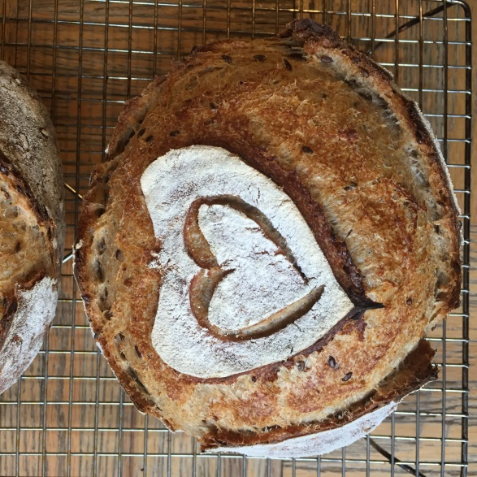
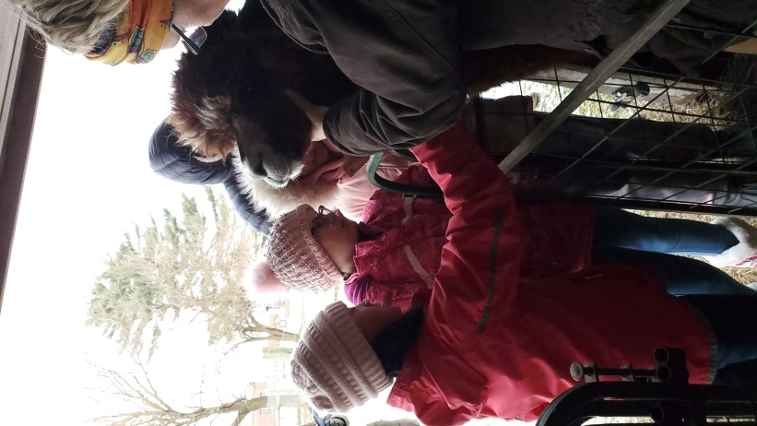
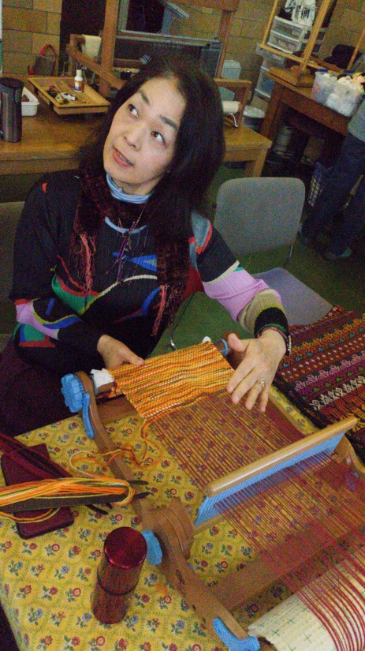
Teaching…
Interns
Volunteers
Students
Adults

Slide 13
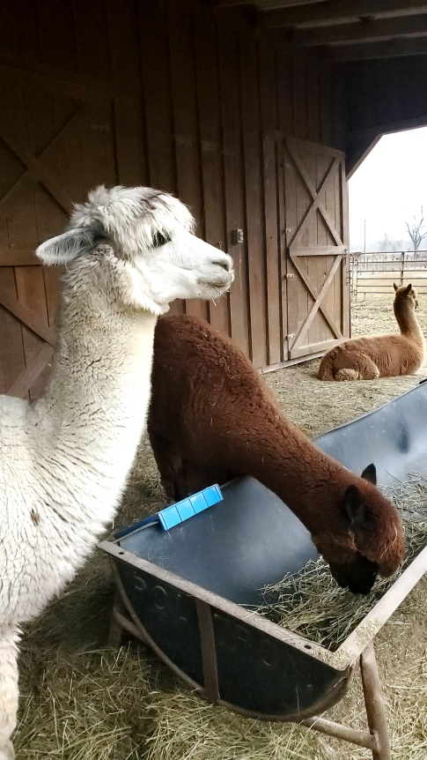
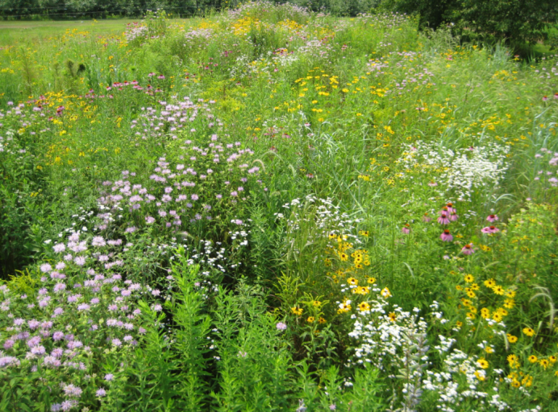
Caring…
Forestry
Farmland
Pollinator Habitat and Bees
Gardens
Alpacas
Chickens
Earth!
Climate Change Task Force

Slide 14
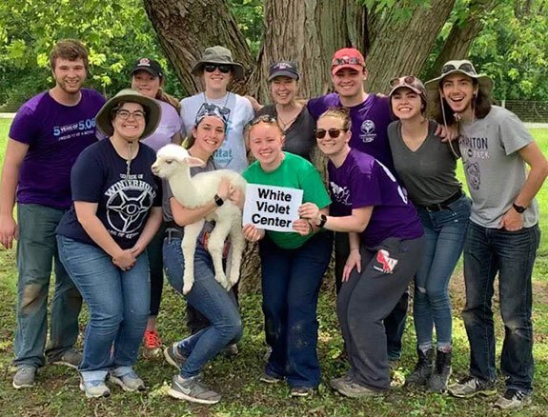
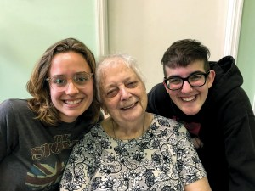
Inspiring!
Donors
Visitors
Prospective Sisters and Providence Associates

Slide 15
“We abuse land because we regard it as a commodity belonging to us. When we see land as a community to which we belong, we may begin to use it with love and respect.” –Aldo Leopold

Slide 16
Justice Focus: Environment and Climate Change
Focus determined at General Chapter 2016
Climate Change Task Force established
Climate Change Manifesto 2017
Providence Climate Agreement
Communication Efforts
Political advocacy

Slide 17
Providence Climate Agreement
Meet people where they are
Commitment forms
Based on “Low Carbon Diet”
Original goal: 2 million pounds
New goal: 4 million by July 1, 2021

Slide 18
Laudato Si Action Platform
A Renewed Direction

Slide 19
A Spiritual Grounding…
“… Christians in their turn ‘realize that their responsibility within creation, and their duty towards nature and the Creator, are an essential part of their faith.’” (Laudato Si paragraph 64) and
“Everything is interconnected, and this invites us to develop a spirituality of that global solidarity which flows from the mystery of the Trinity.” (Laudato Si paragraph 240)

Slide 21
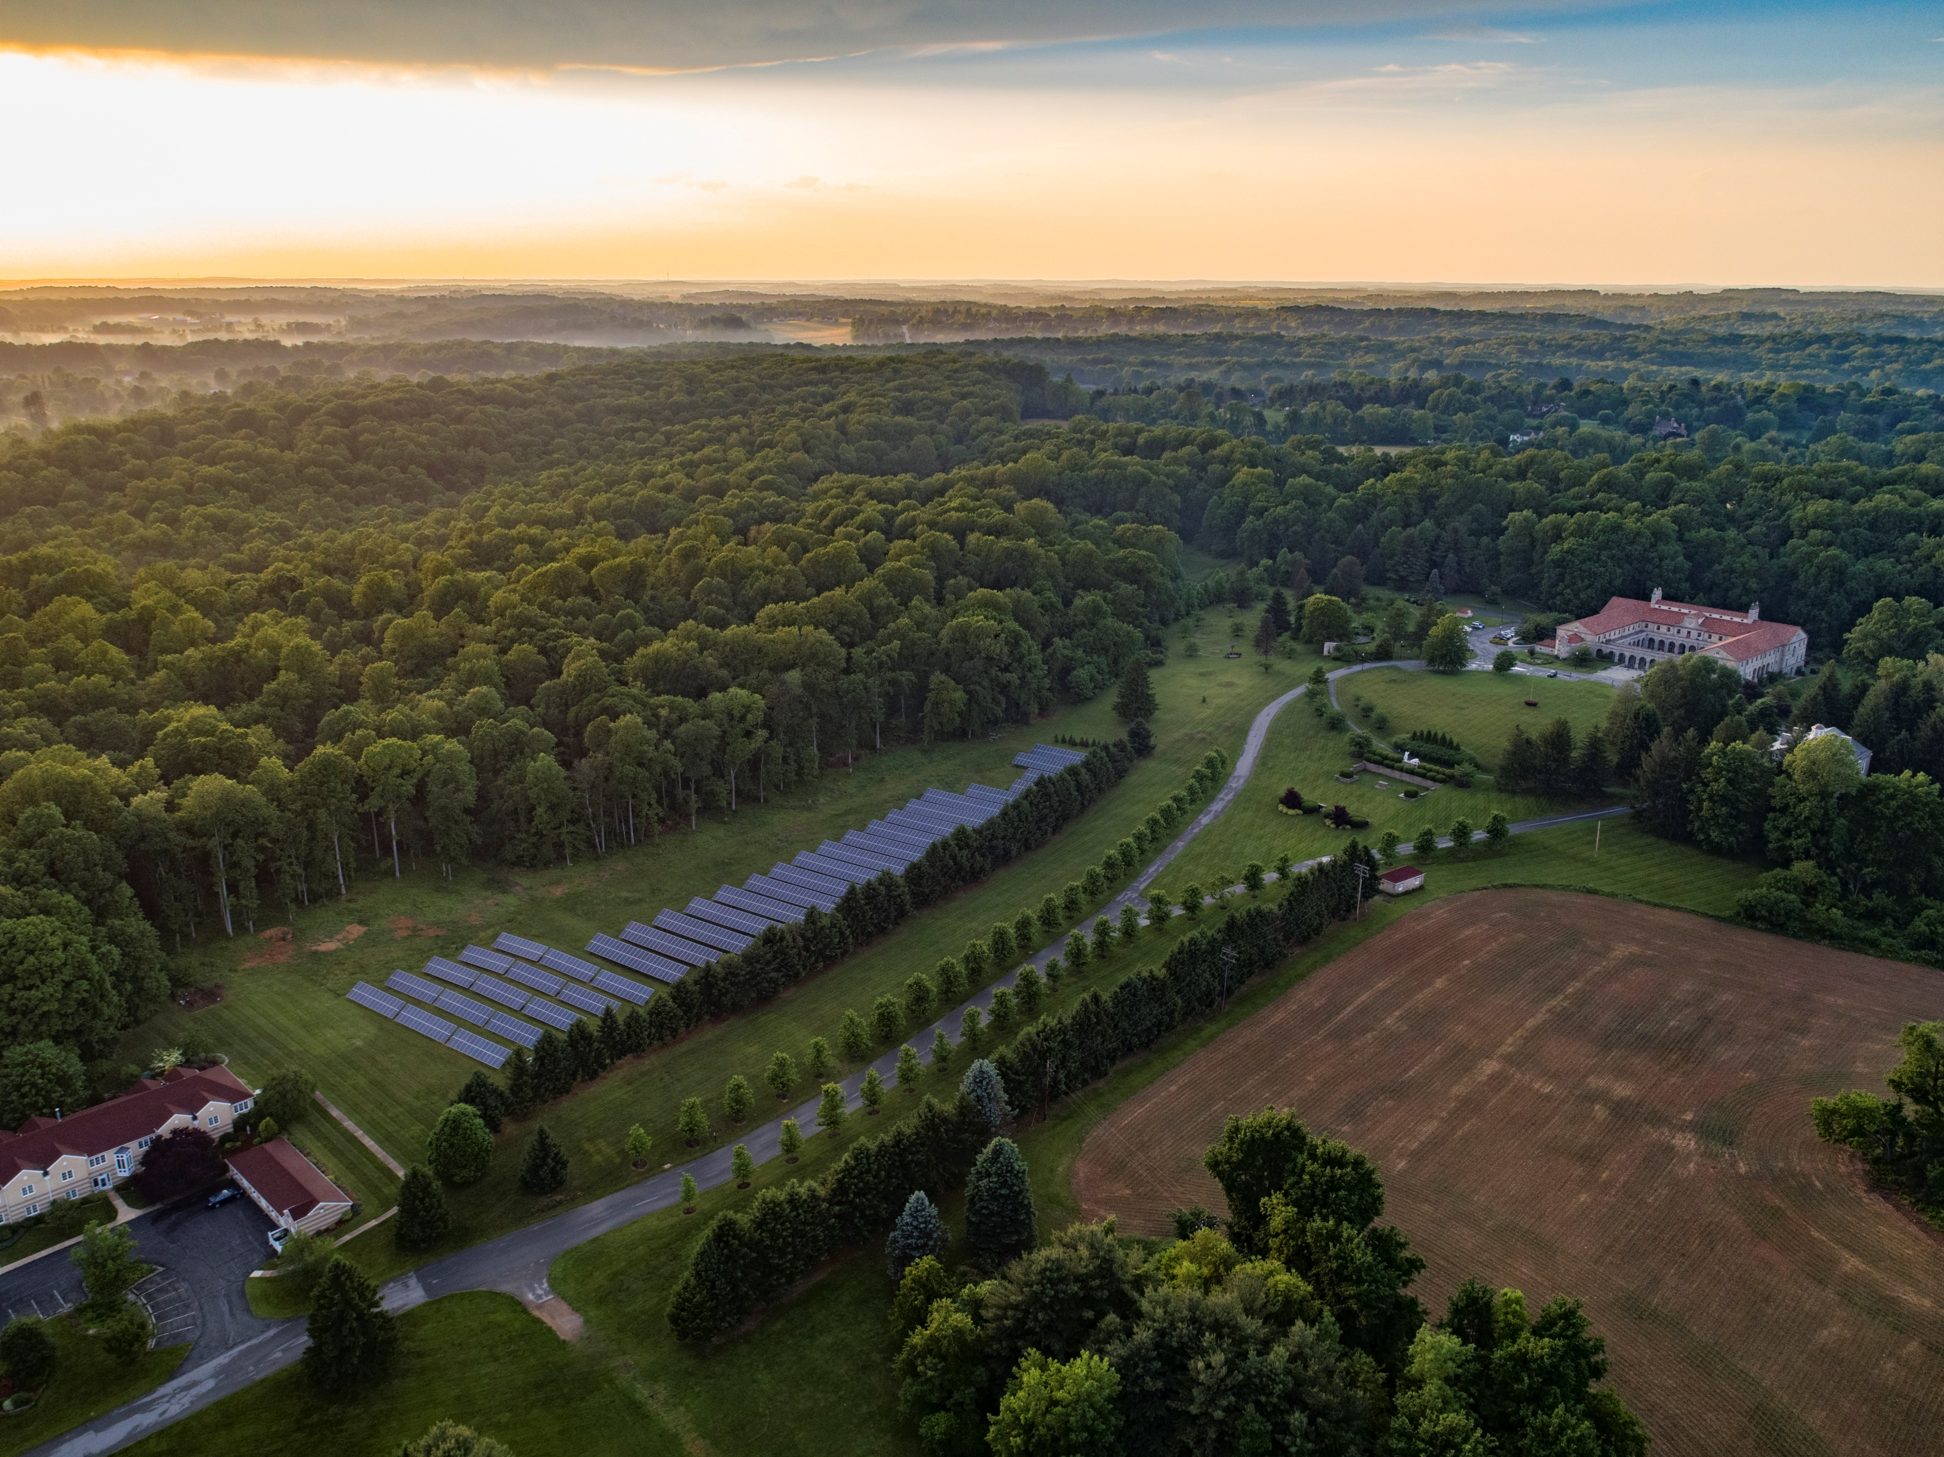
3 acre farm located in Ellicott City, MD
Ministry of Franciscan Friars Conventual
100% of produce is donated to those in need in Baltimore
Dedicated to regenerative farming practices to care for our land
First vegetables planted June 2019
Volunteer-run, all done by hand

Slide 22
“Today, however, we have to realize that a true ecological approach always becomes a social approach; it must integrate questions of justice in debates on the environment, so as to hear both the cry of the earth and the cry of the poor.”
– Laudato Si’, par. 49

Slide 23
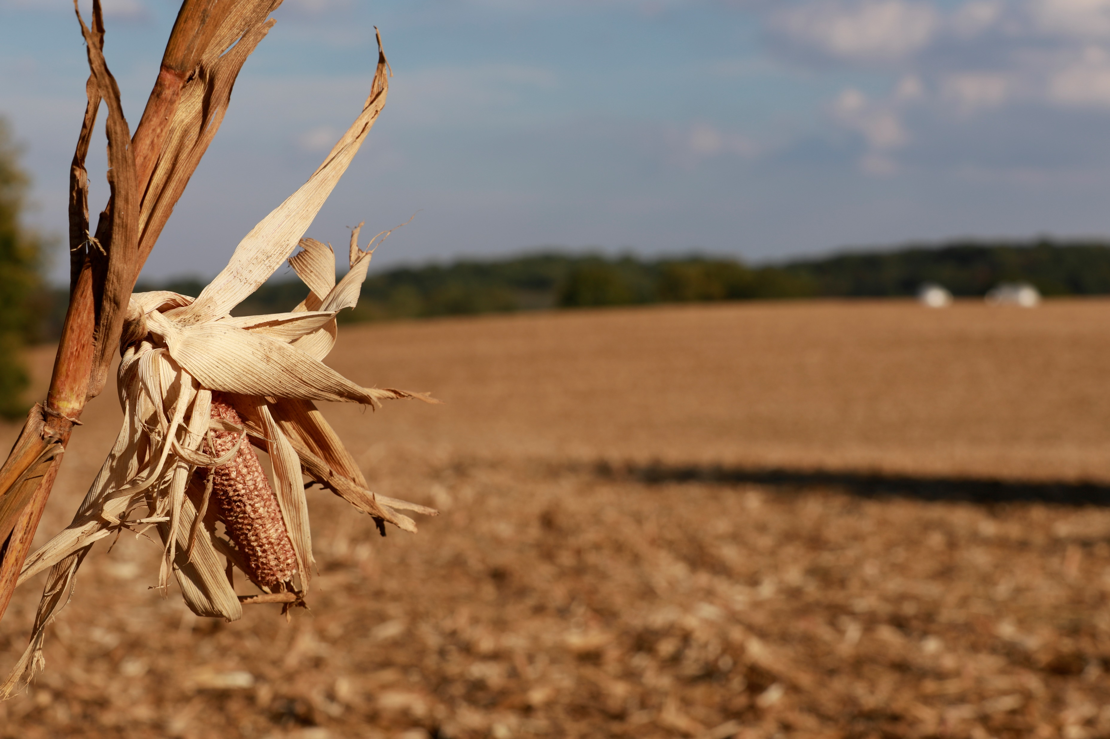

Slide 24
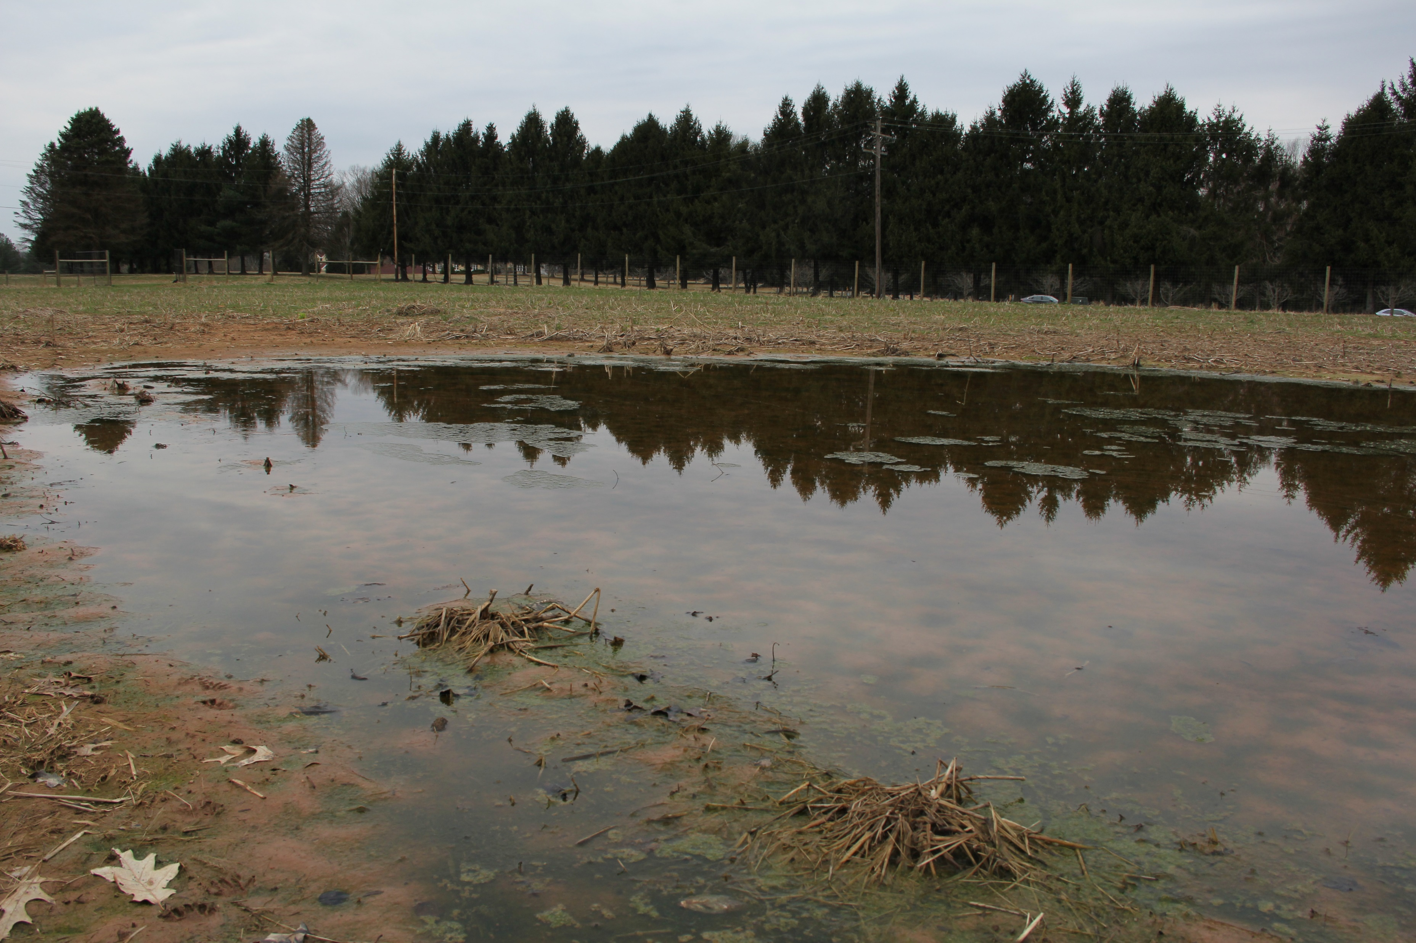

Slide 25
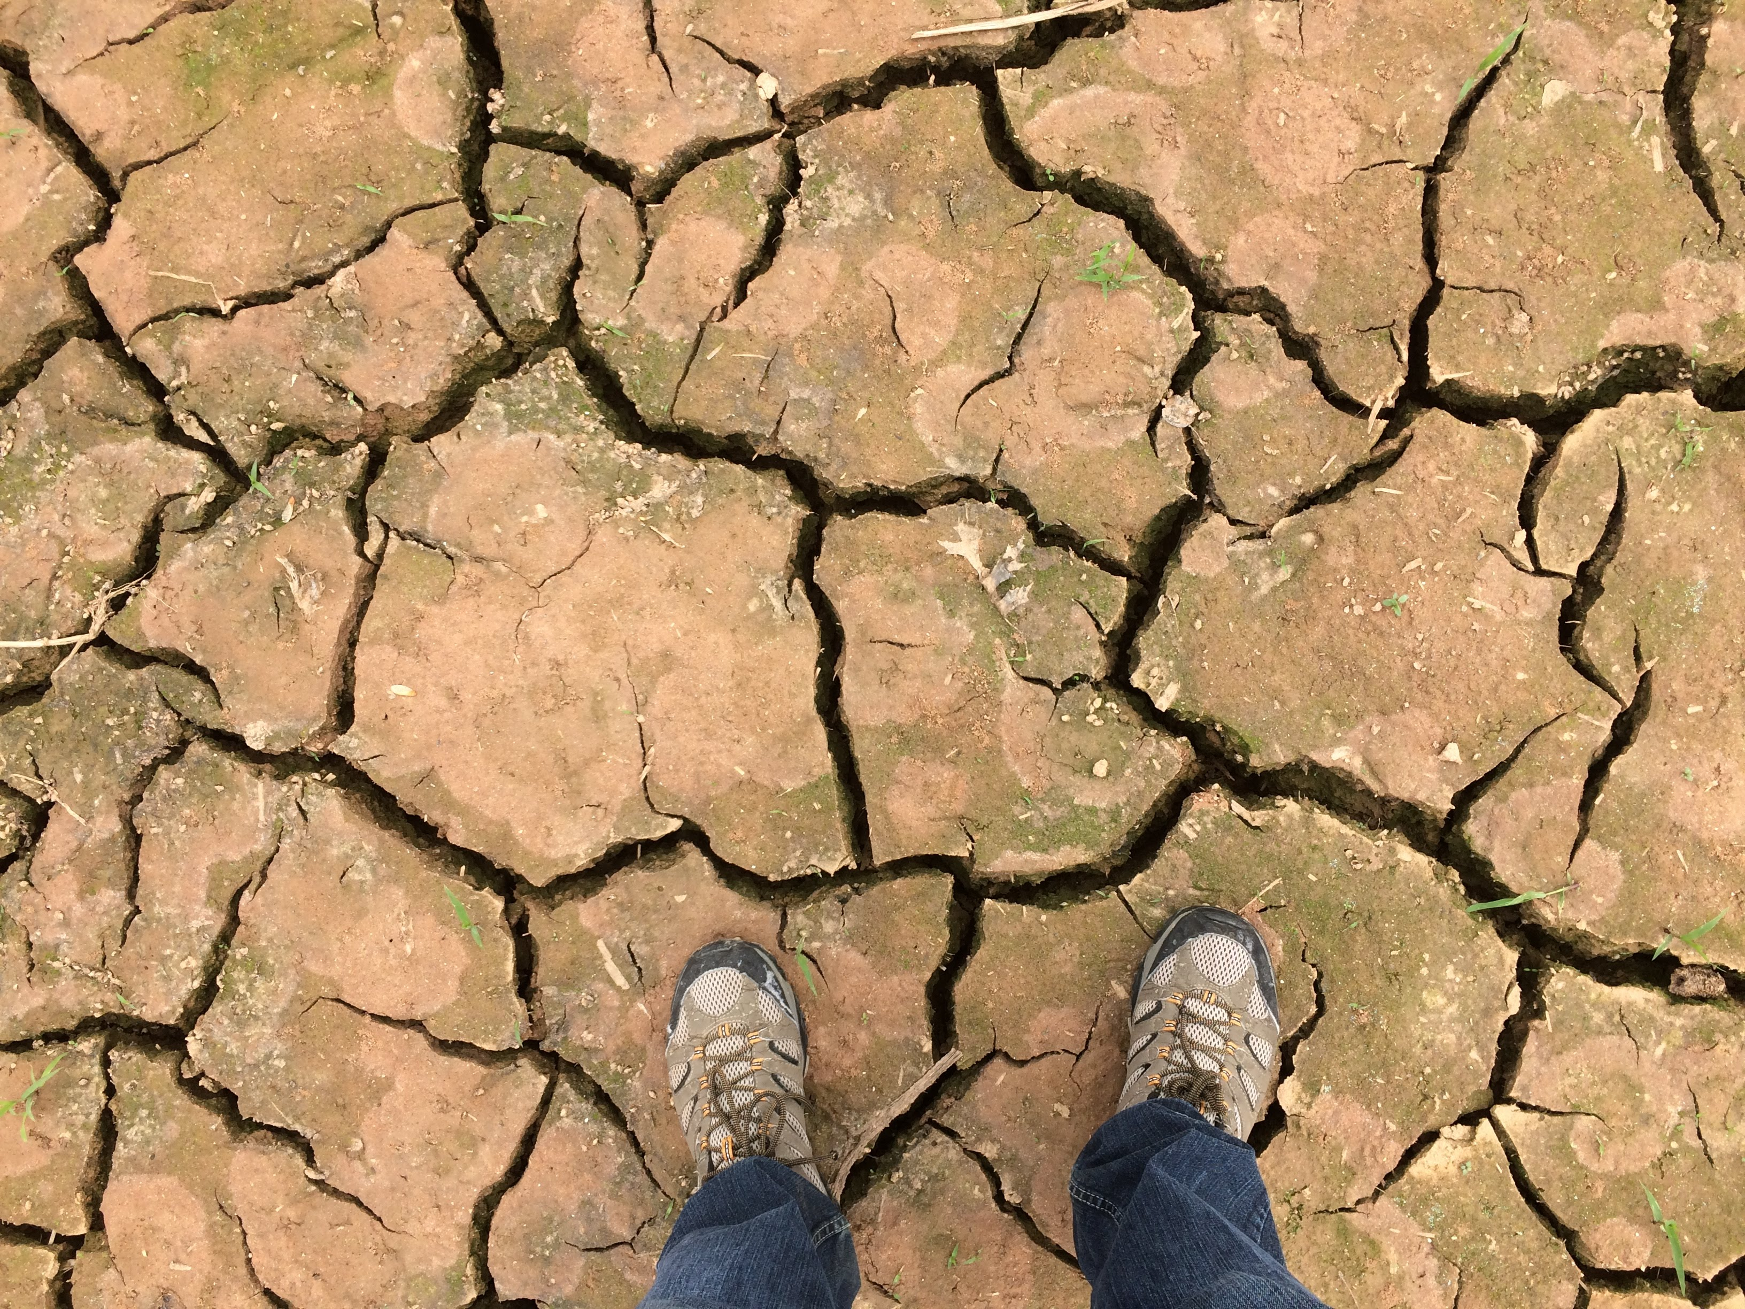

Slide 26
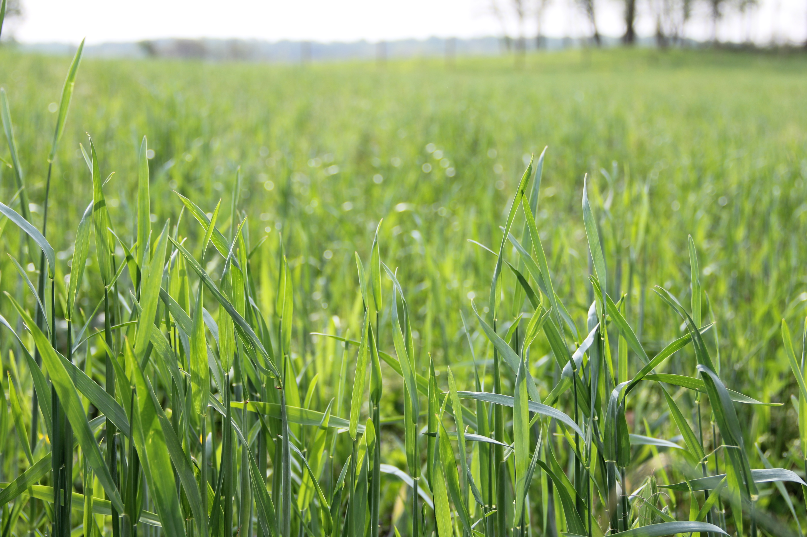
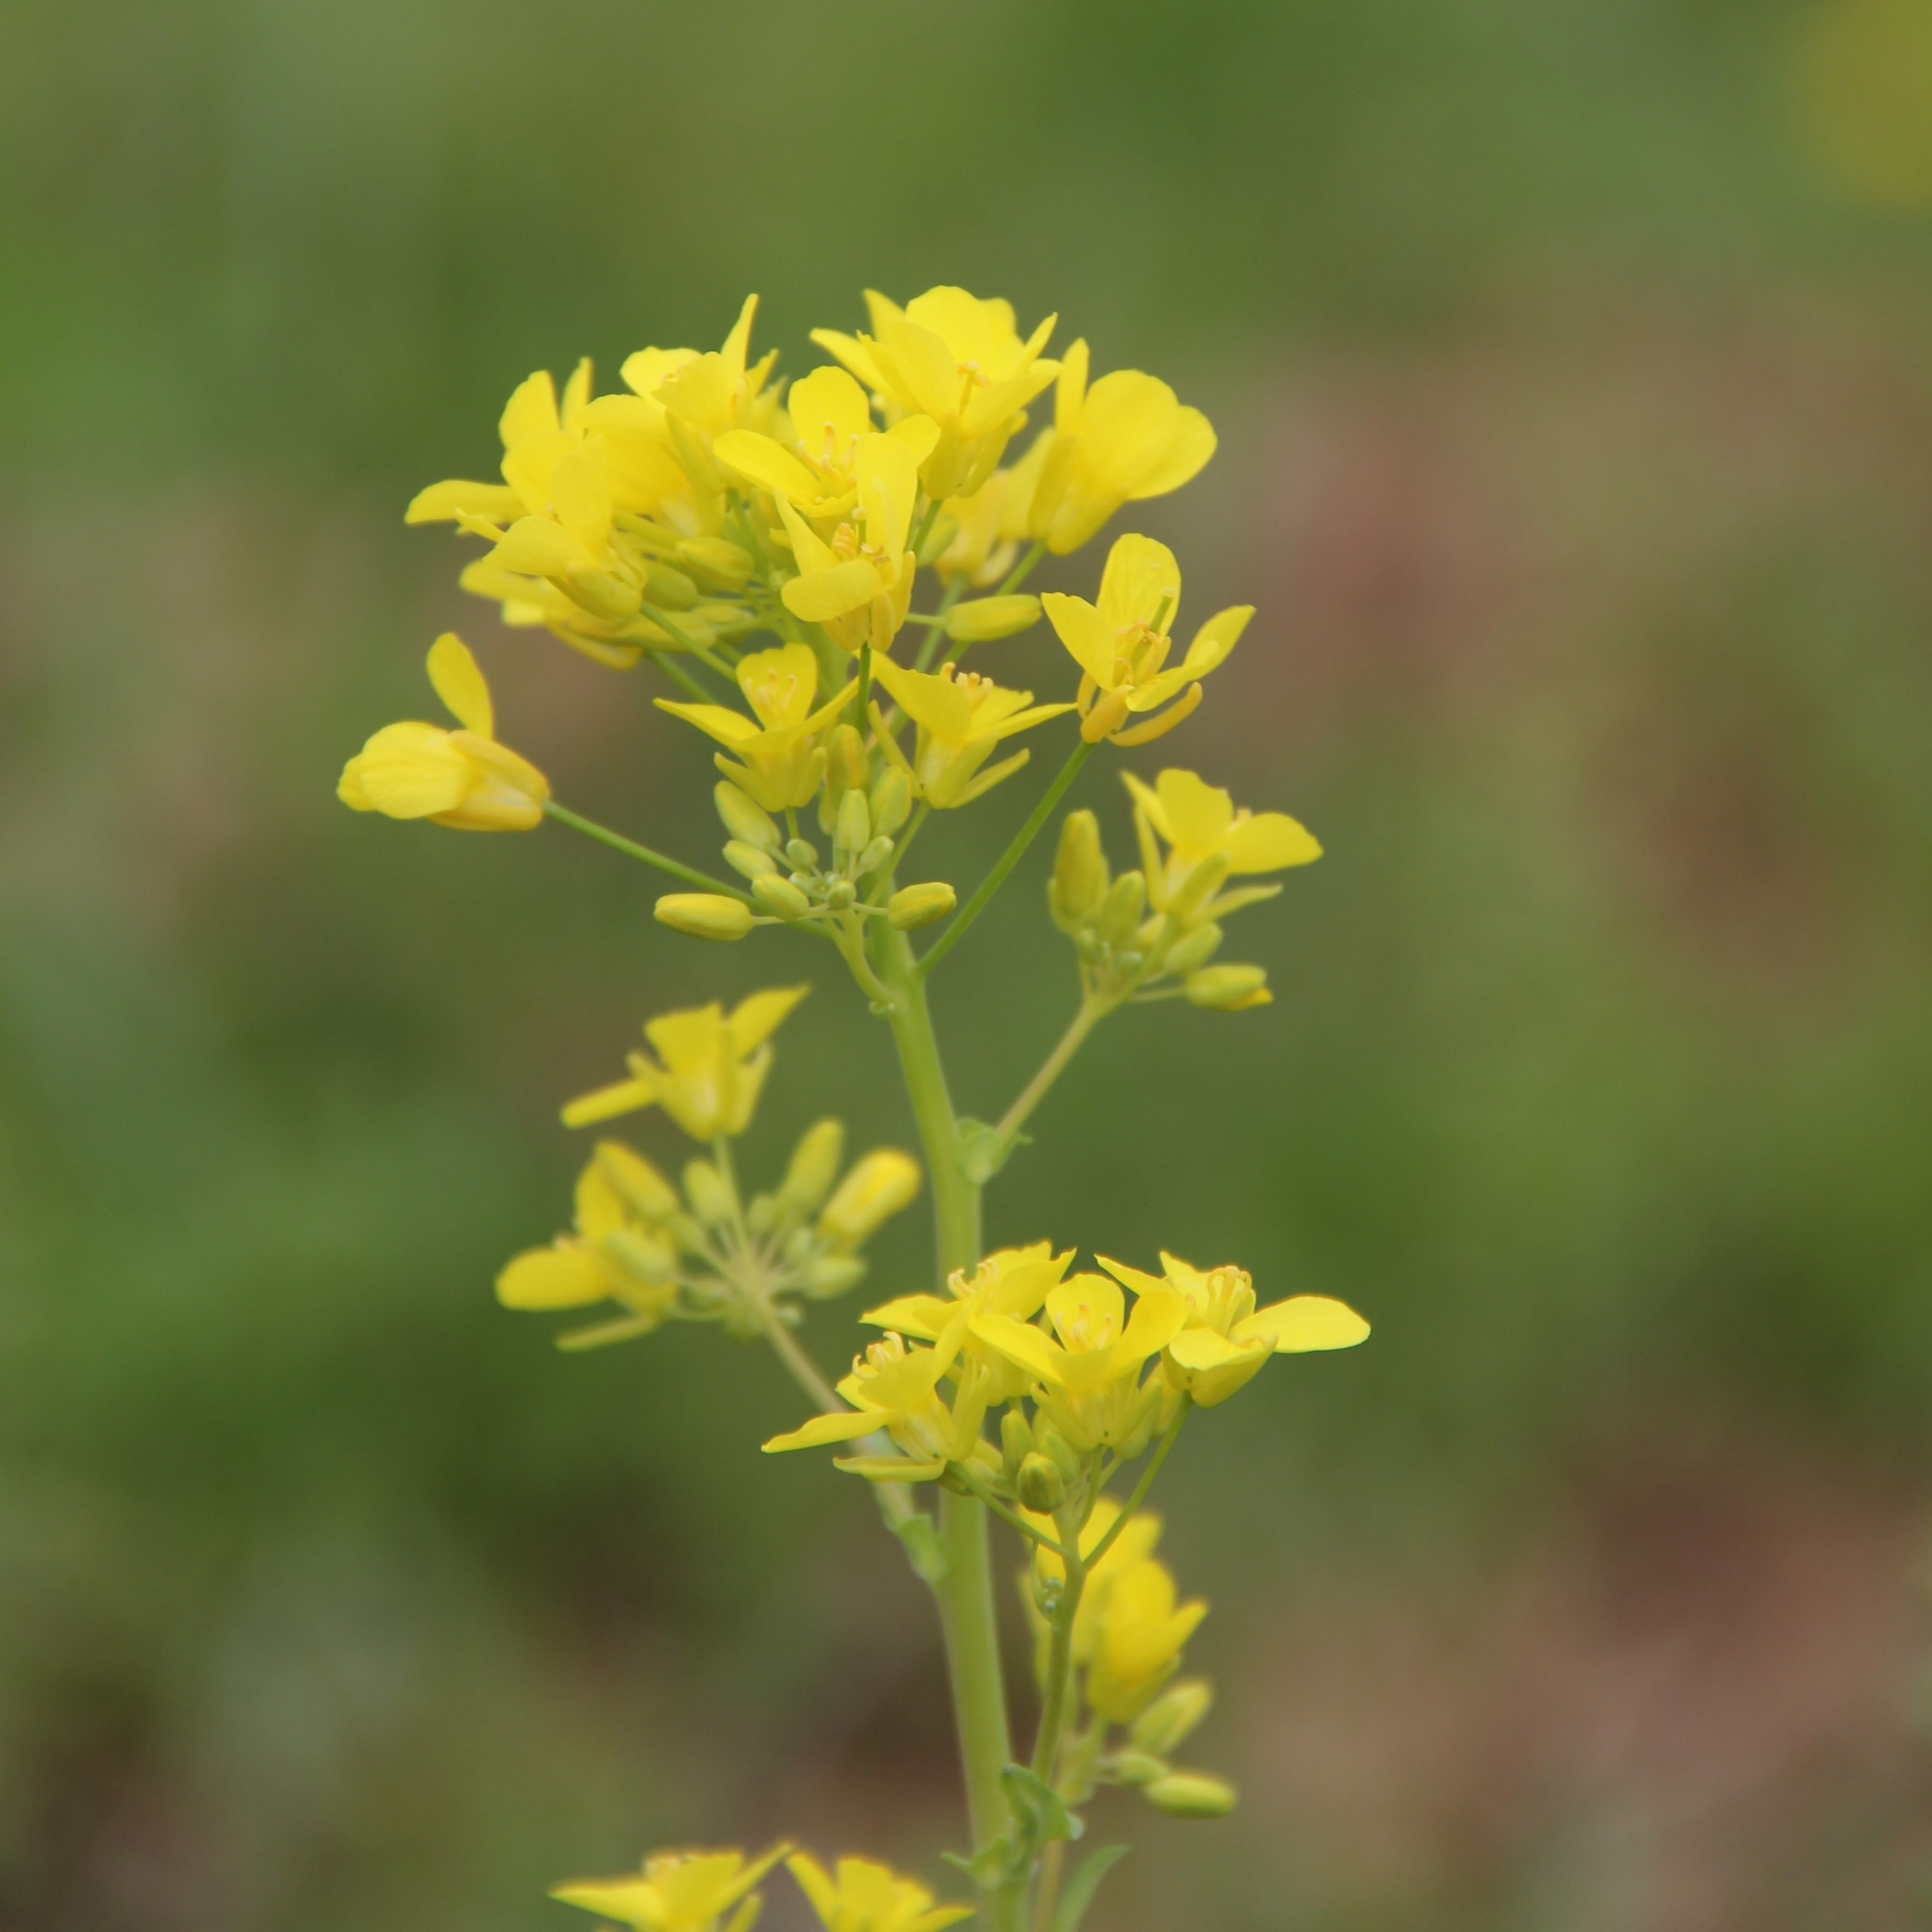
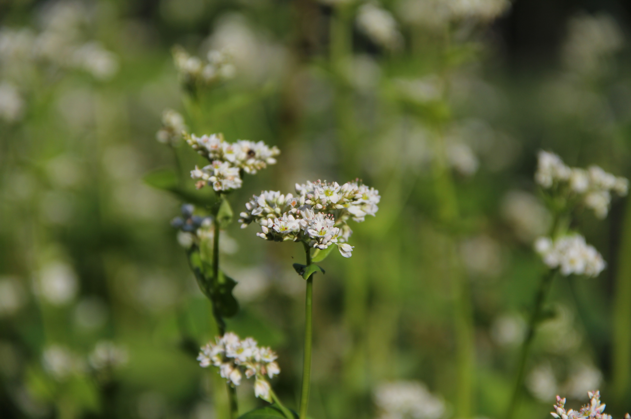

Slide 29
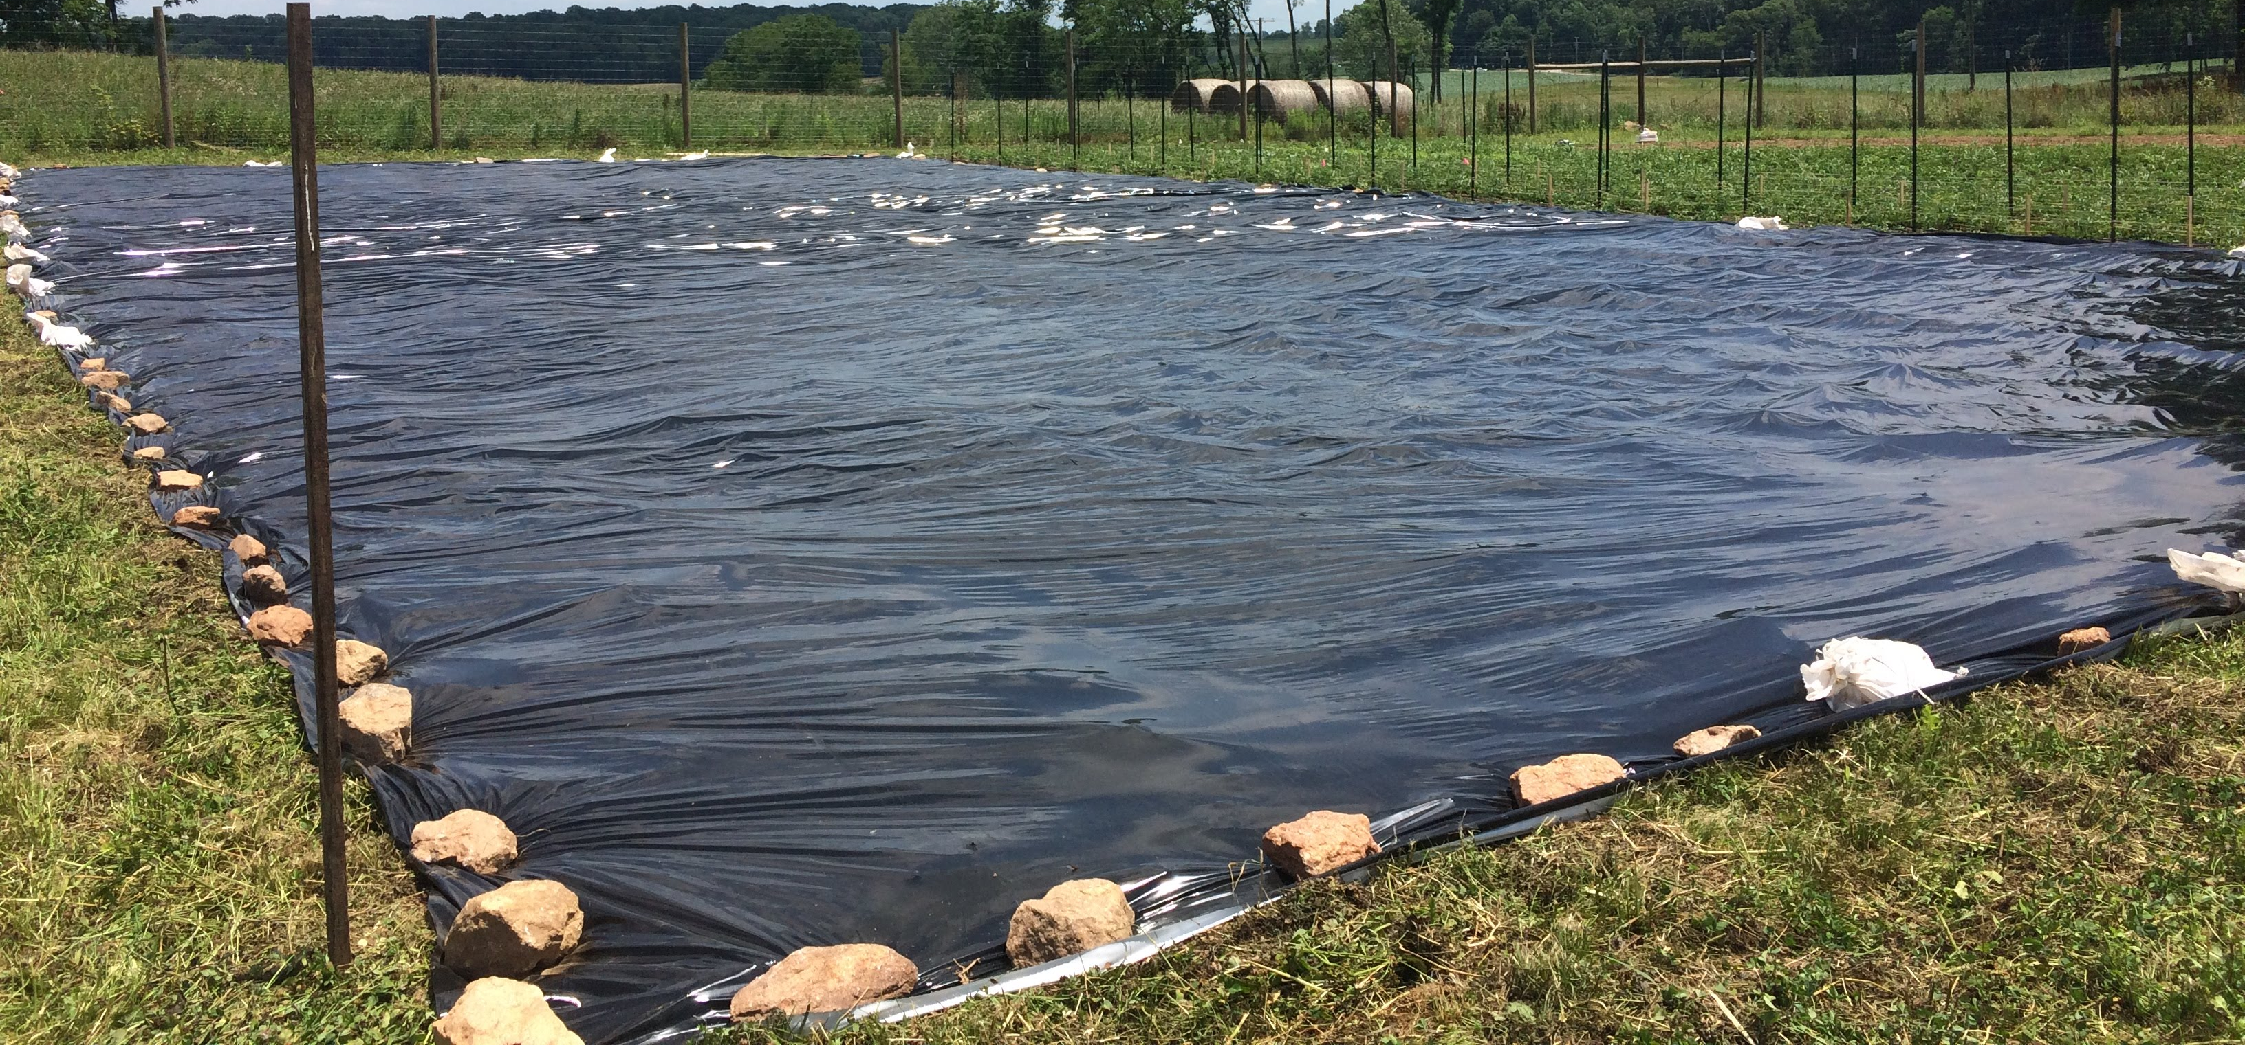

Slide 30
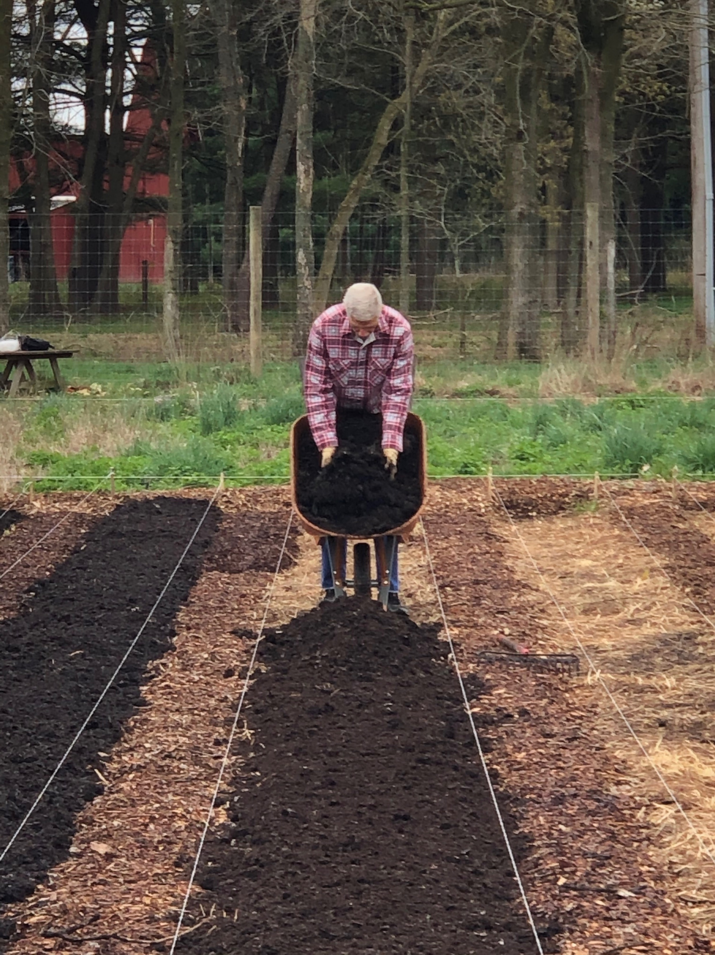

Slide 31
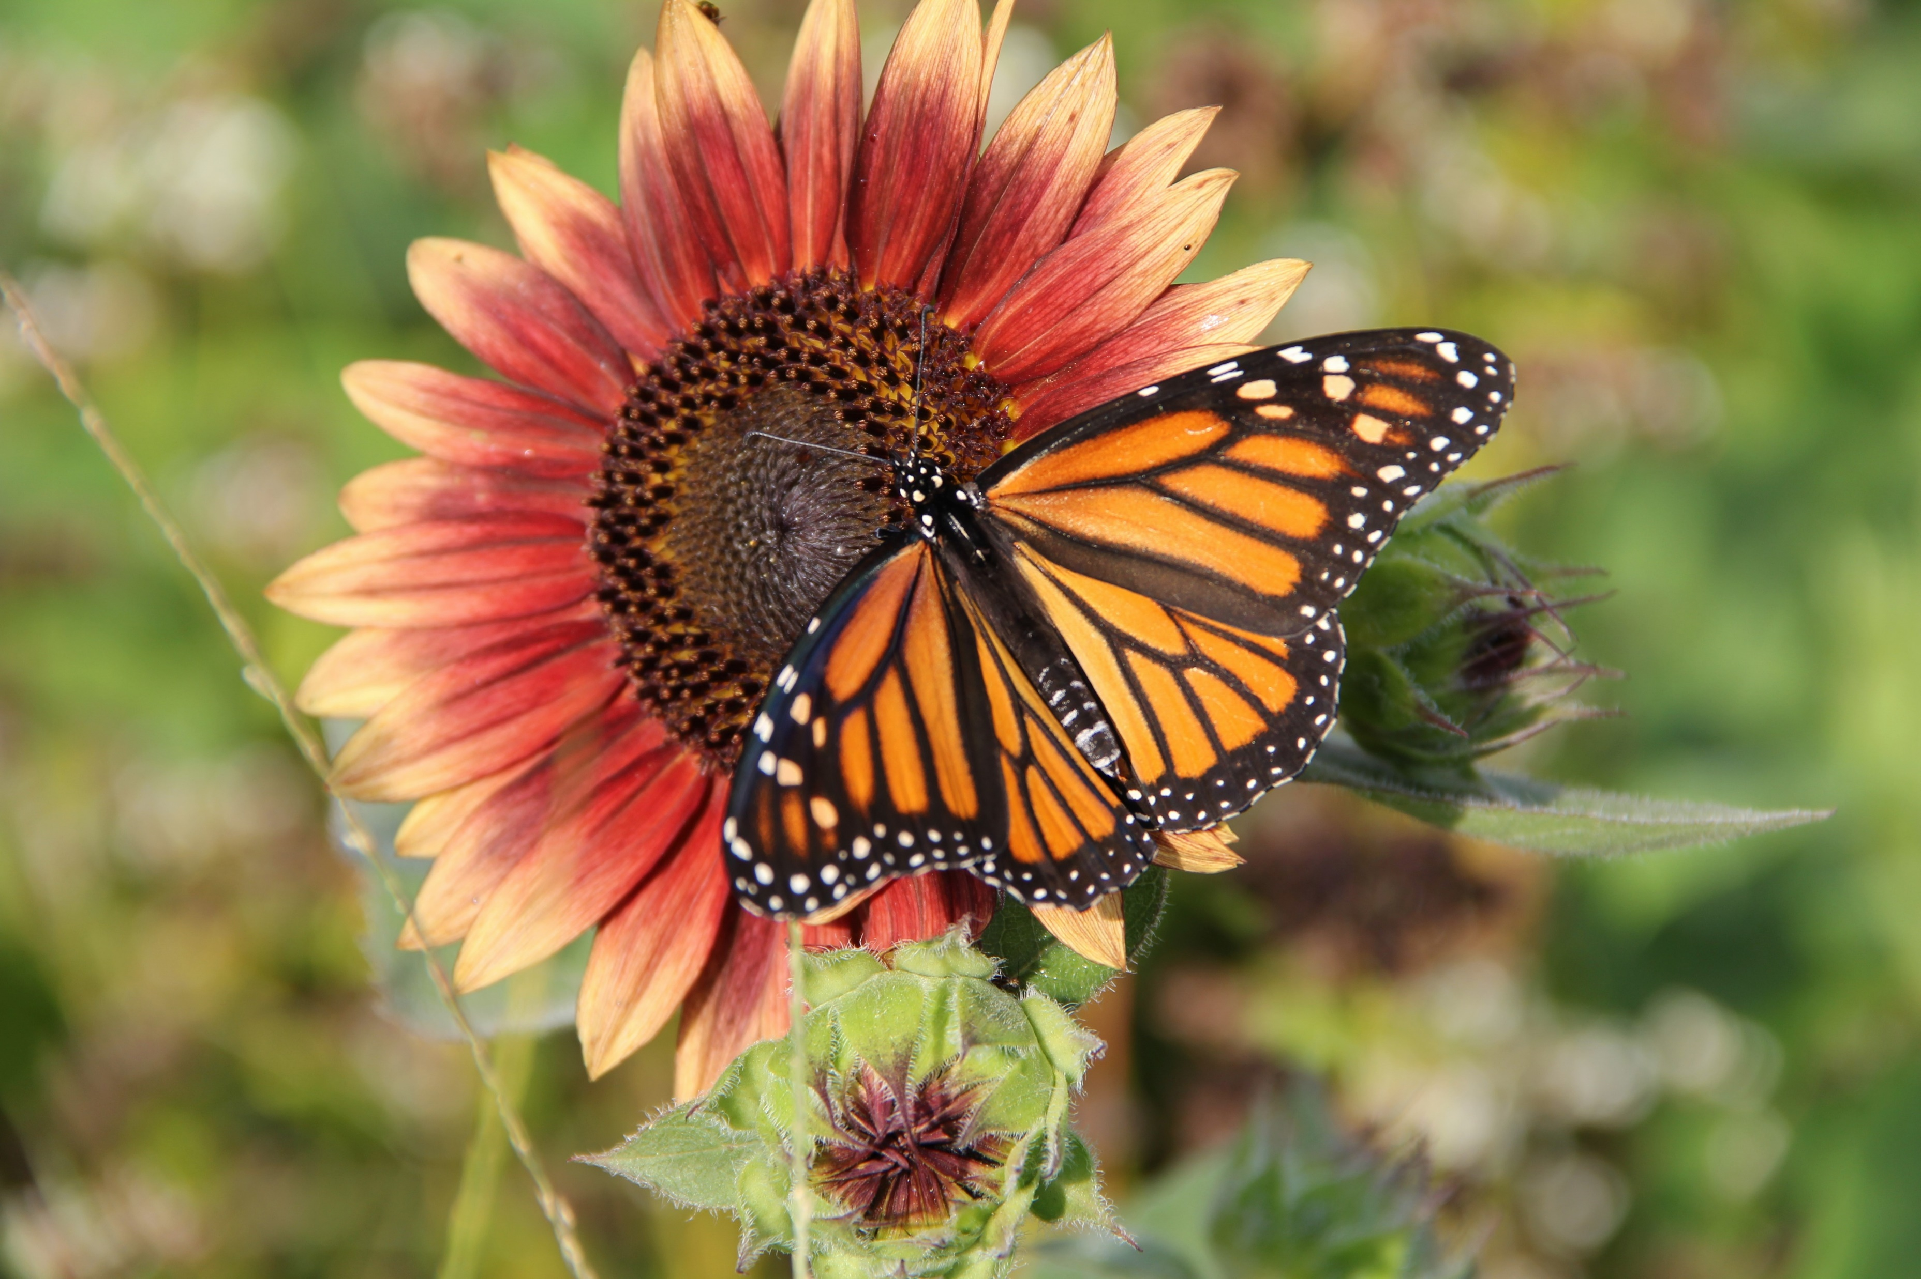
“He commands the gardener to leave the edges of the garden undug, so that in their season the greenness of the grass and the beauty of flowers may proclaim the beauty of the Father of all. It is designated that within the garden there be a smaller garden for aromatic and flowering plants so that those who see them may be diverted by the memory of eternal sweetness.” - Thomas of Celano, biography of St. Francis of Assisi, 13th century

Slide 33
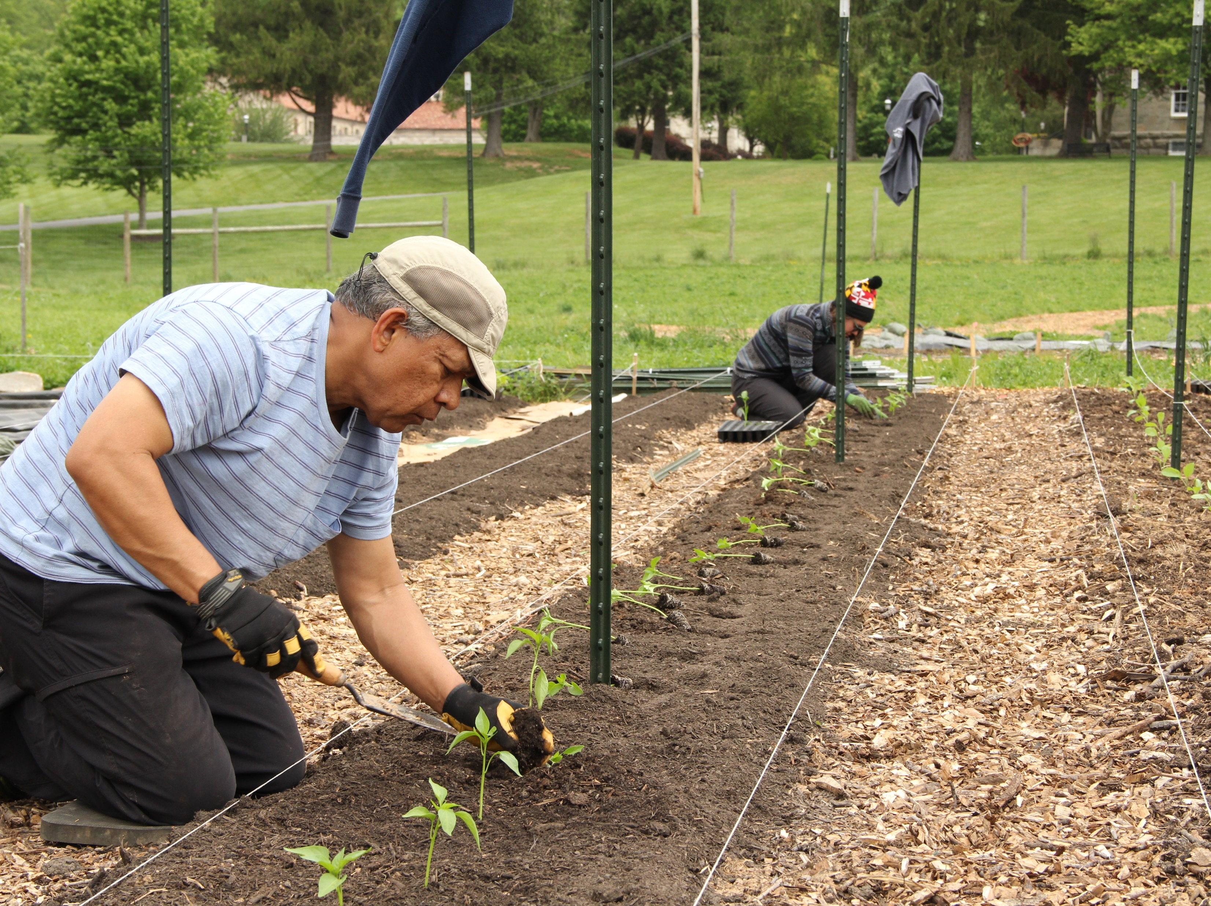
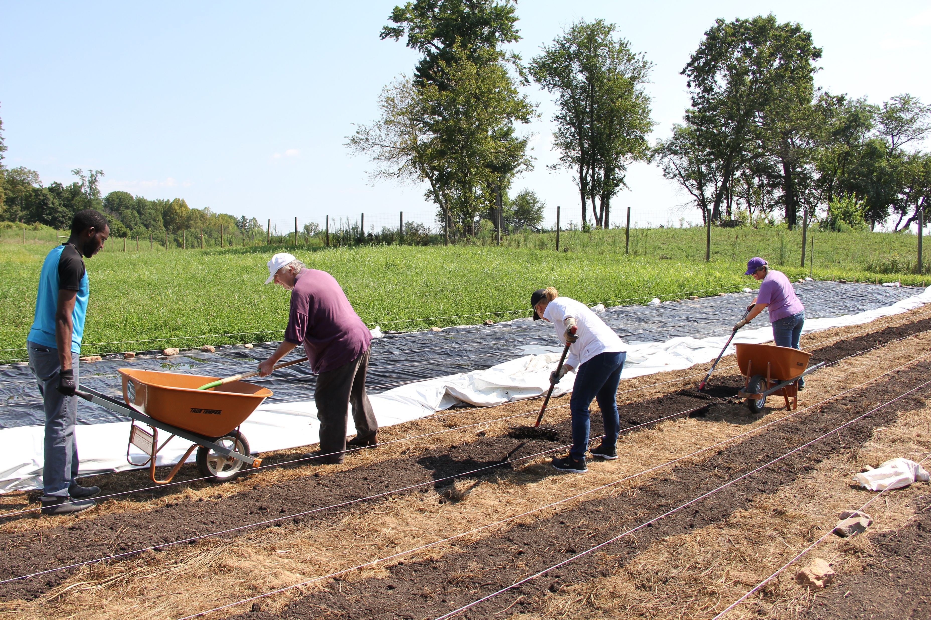
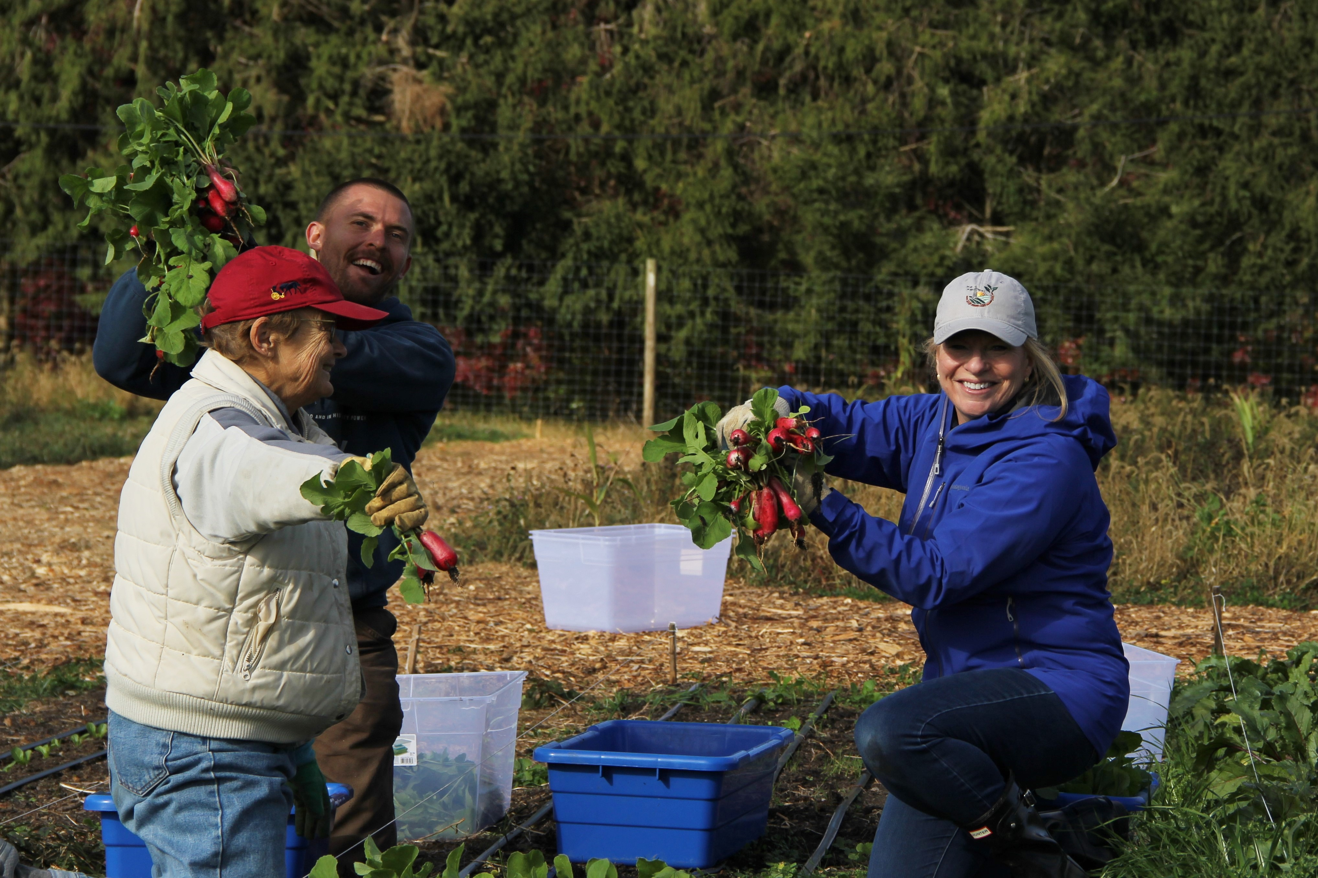

Slide 34
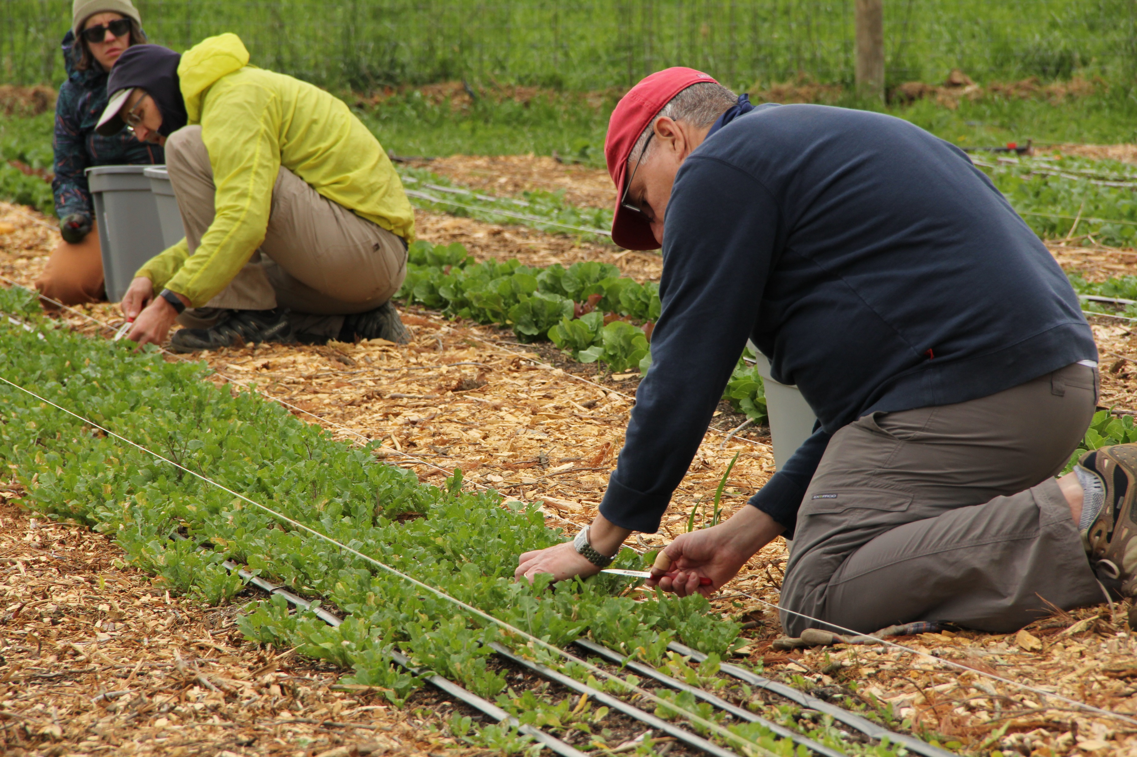
“We were created with a vocation to work. The goal should not be that technological progress increasingly replace human work, for this would be detrimental to humanity. Work is a necessity, part of the meaning of life on this earth, a path to growth, human development and personal fulfilment.”
- Laudato Si’, par. 128

Slide 35
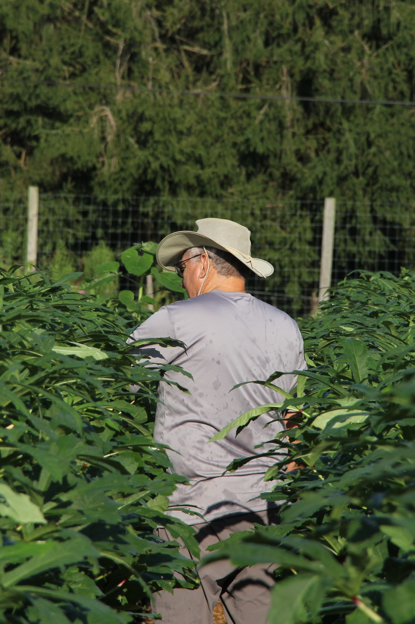
“The means we use to do our work almost certainly affect the way we look at the world...I now suspect that if we work with machines the world will seem to us to be a machine, but if we work with living creatures the world will appear to us as a living creature.”
- Wendell Berry, “Renewing Husbandry” (2004)

Slide 36
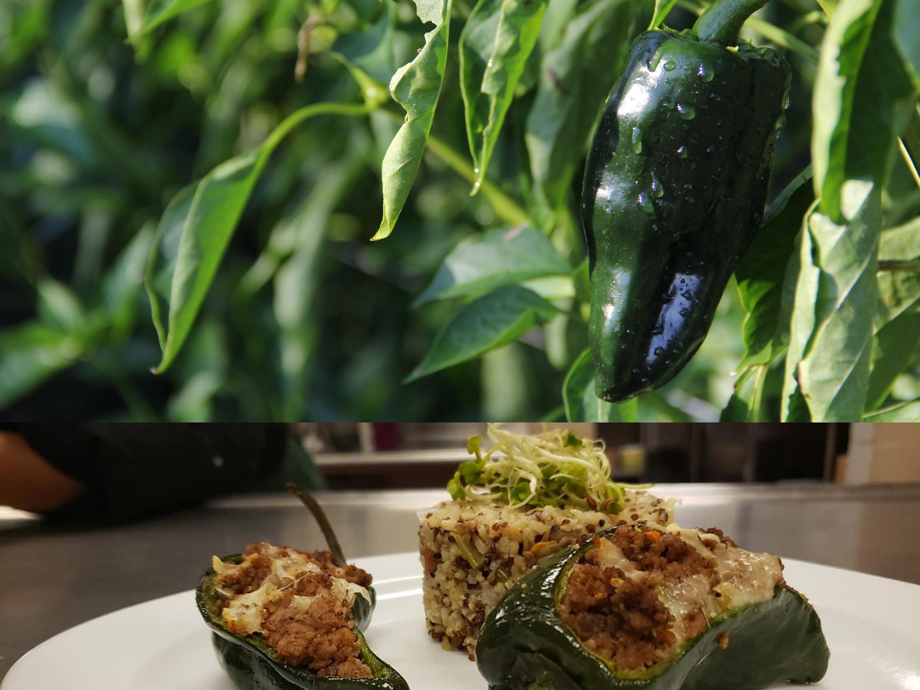

Slide 37
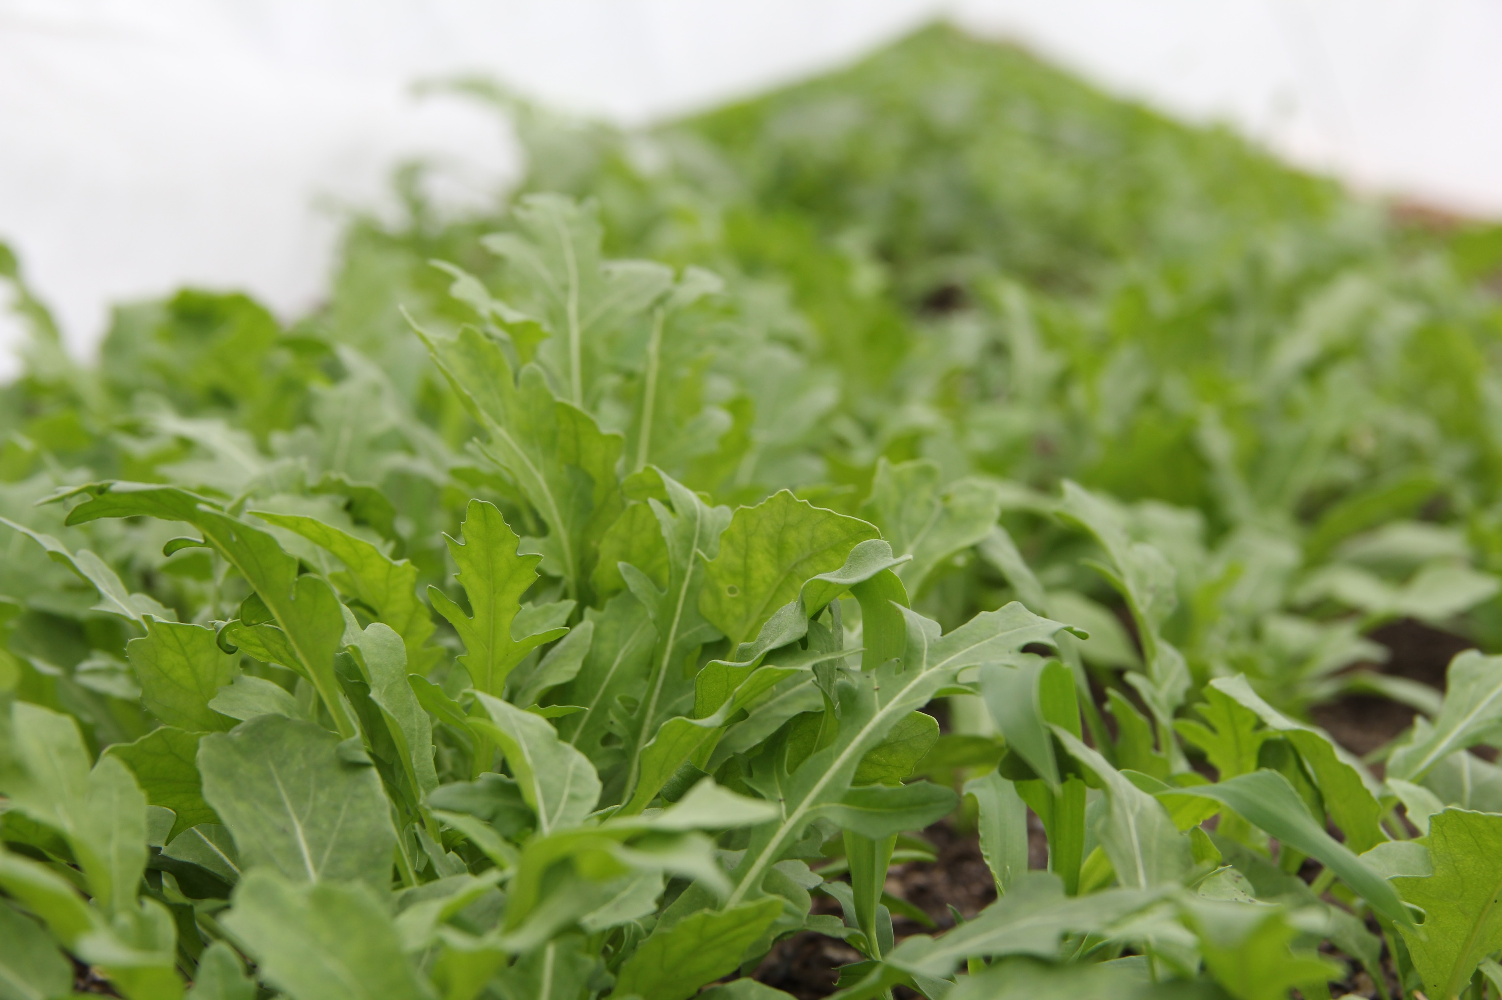
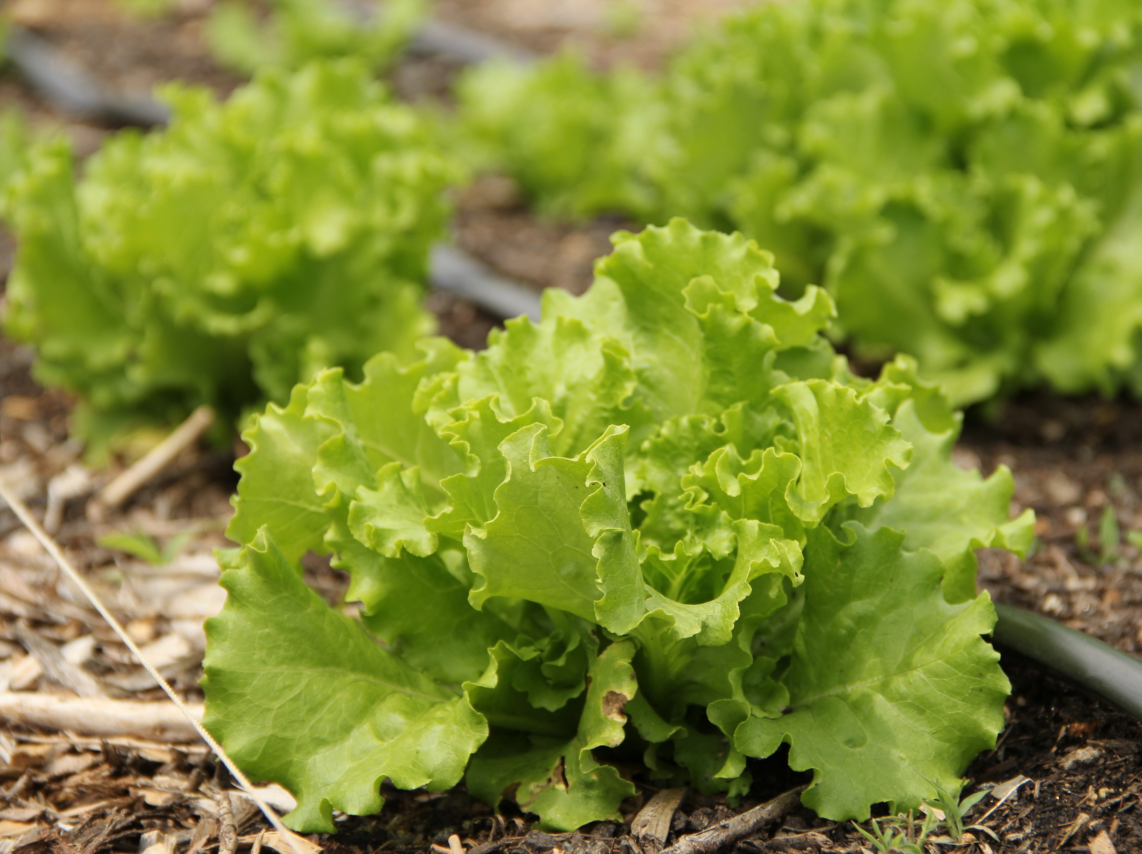
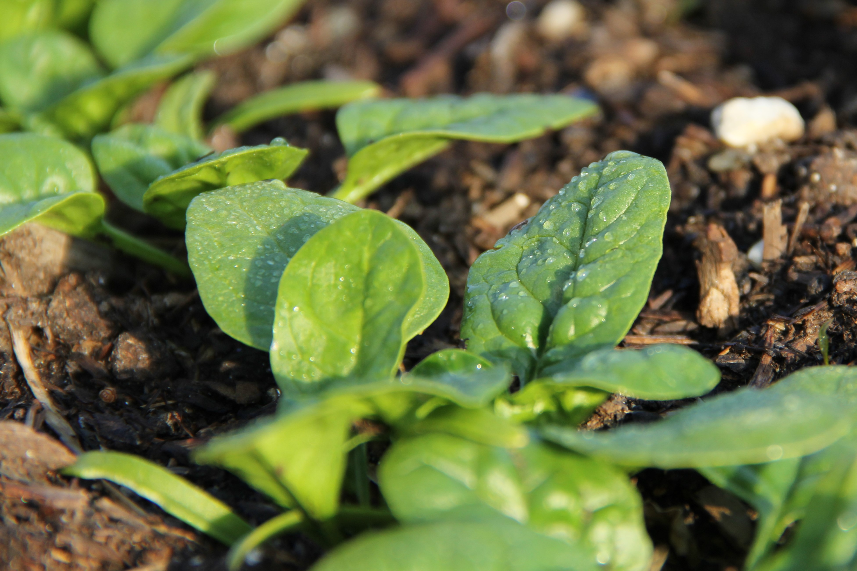

Slide 38
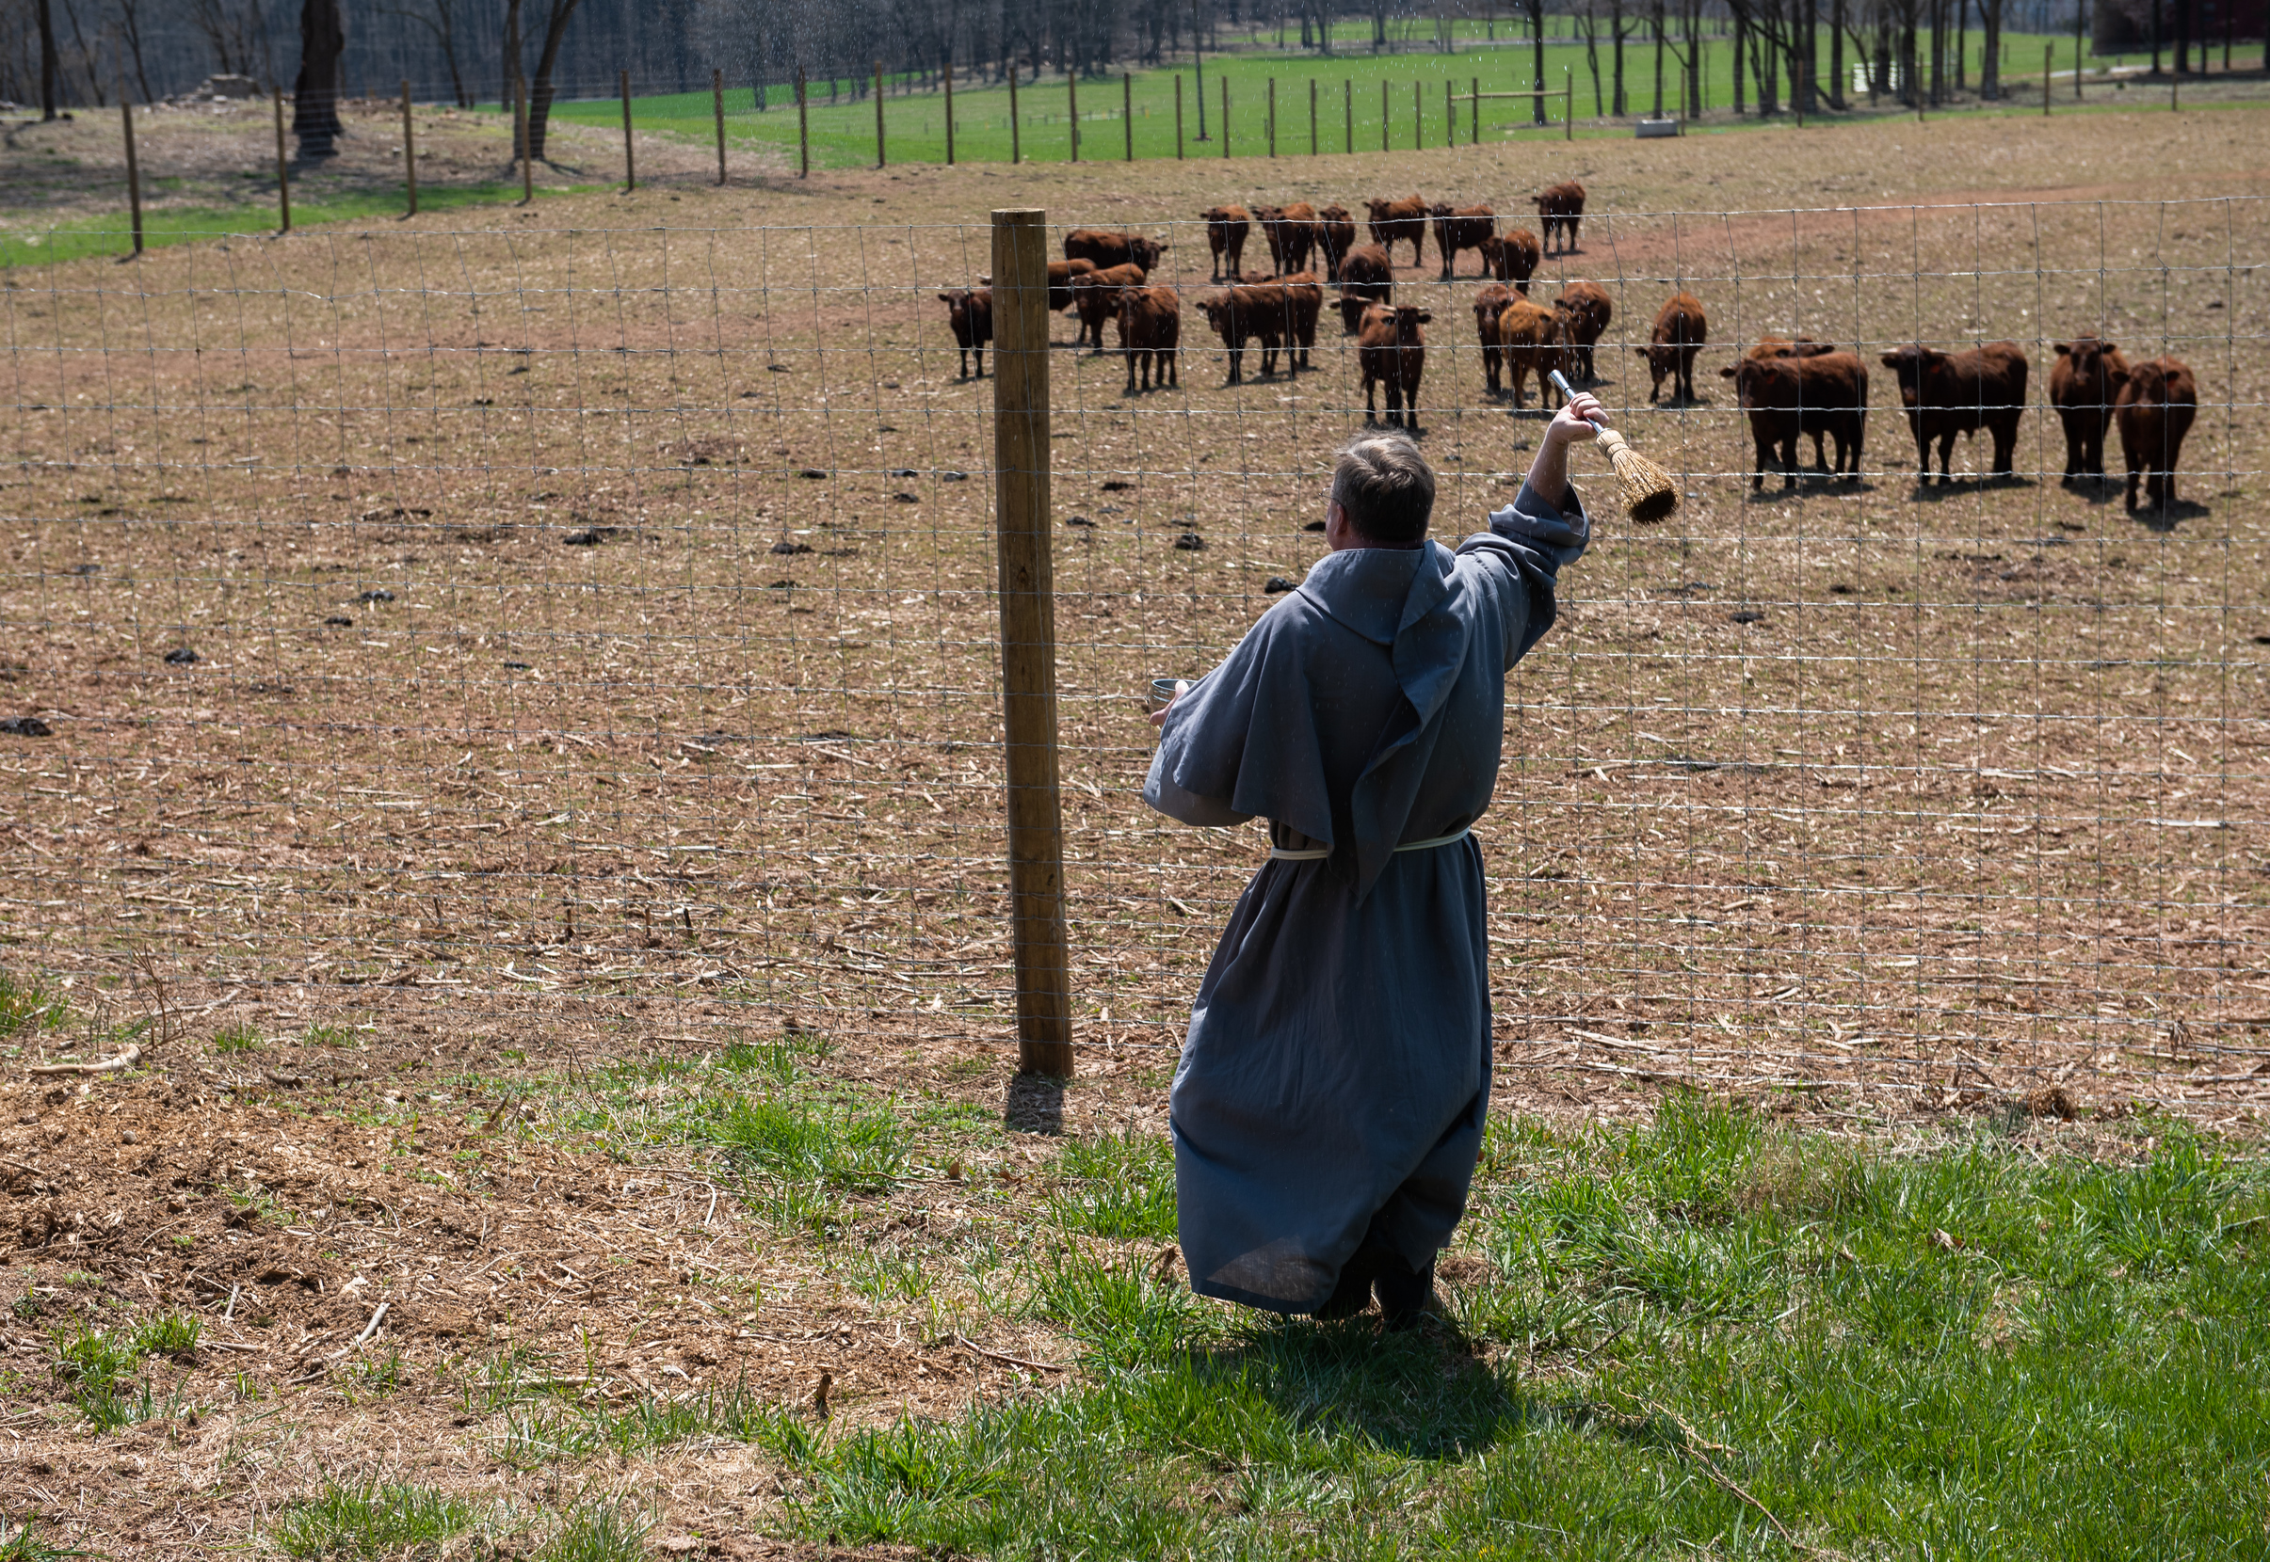
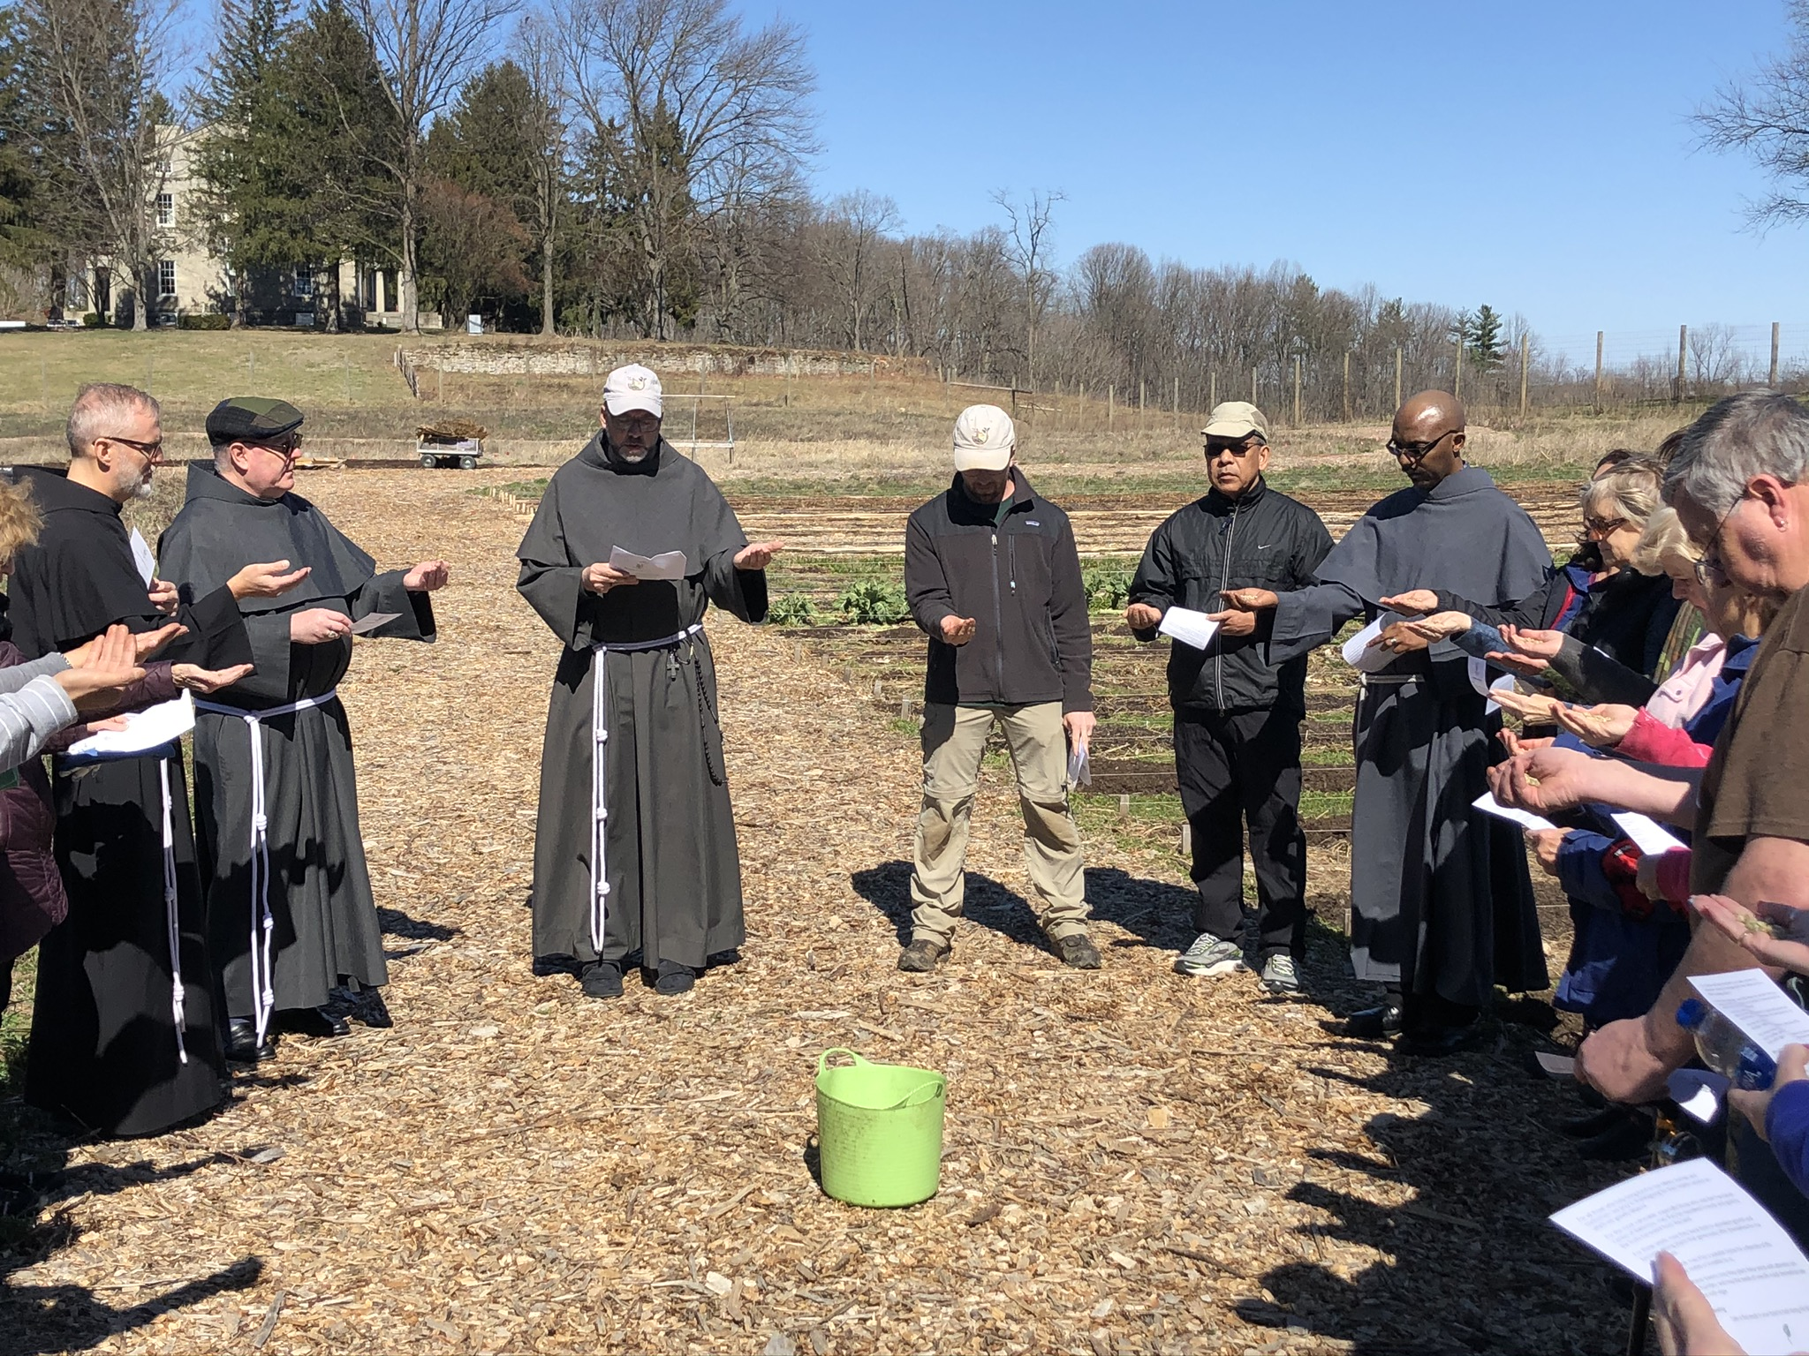
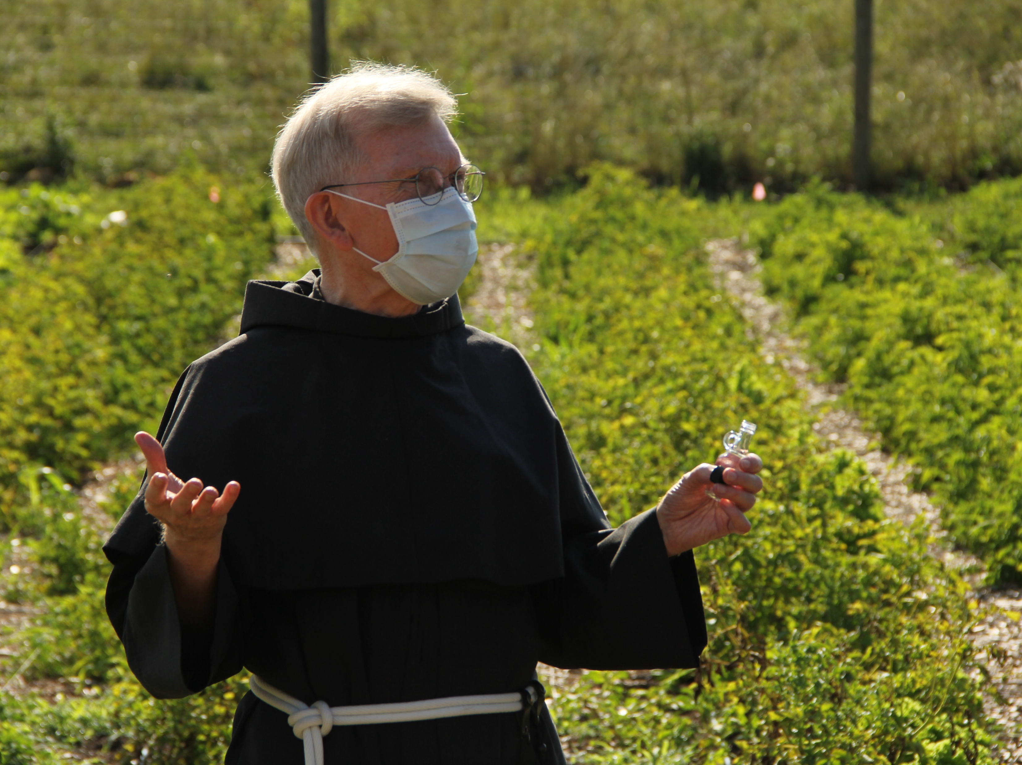

Slide 39
“It is good for people to realize that purchasing is always a moral — and not simply economic — act.
– Pope Benedict XVI, Caritas in Veritate, par. 66

Slide 40
“I ask all believers to return to this beautiful and meaningful custom. That moment of blessing, however brief, reminds us of our dependence on God for life; it strengthens our feeling of gratitude for the gifts of creation; it acknowledges those who by their labours provide us with these goods; and it reaffirms our solidarity with those in greatest need.”
– Laudato Si’, par 227

Slide 41
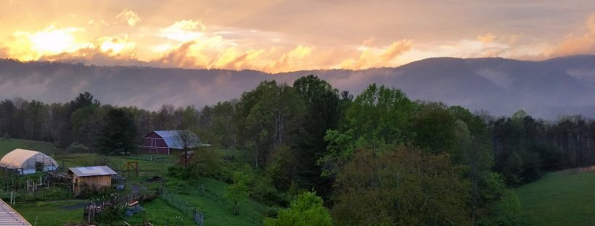
BETHLEHEM FARM
Molly Sutter, Caretaker

Slide 42
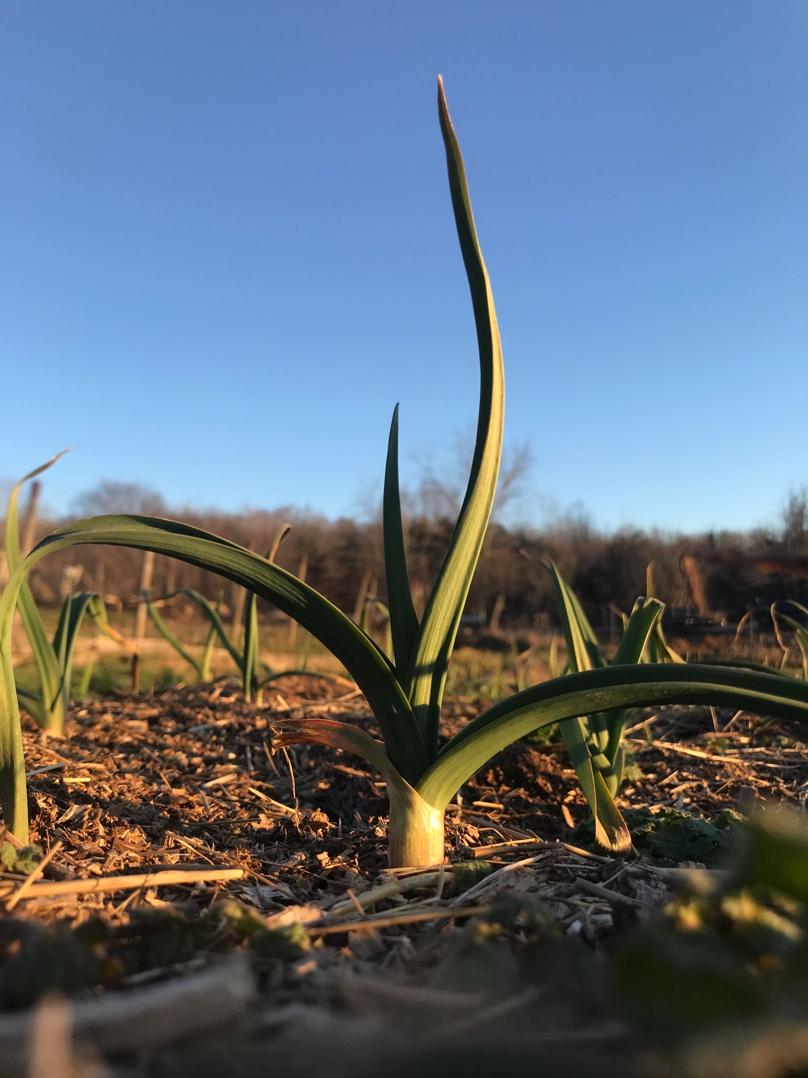
Care for Creation
The goods of Earth are gifts from God and are intended for the benefit of all. We have a responsibility to care for resources as stewards and trustees, not as mere consumers and users. To that end, we are called to be co-creative with God in returning and restoring to Earth that which we take from her.

Slide 43
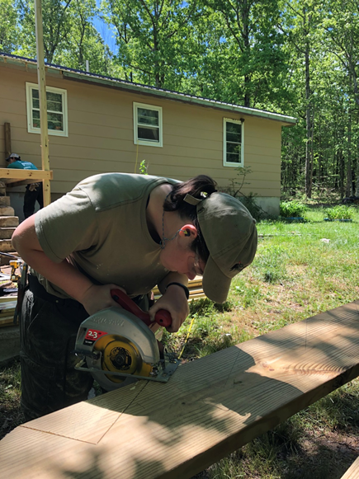
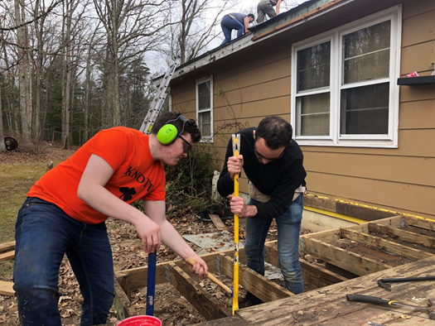
Preferential Option for the Poor and Vulnerable
The moral test of a society is how it treats its most vulnerable members. The poor have the most urgent moral claim on our collective conscience. A community can be healthy only if its members give special attention to those with special needs, to those who are on the margins of society.

Slide 44
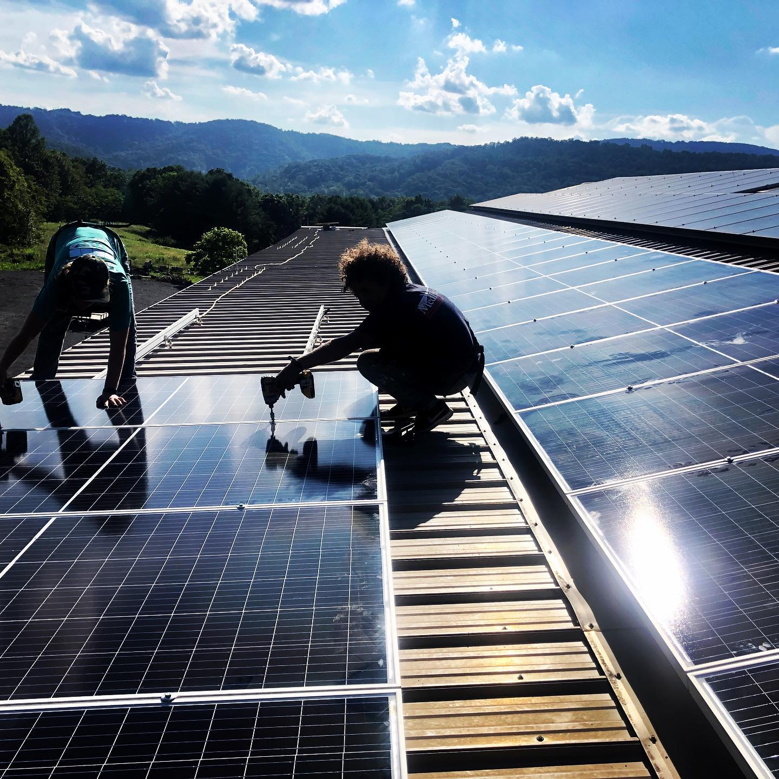
Peace and Disarmament
Catholic teaching promotes peace as an uncompromising, action-oriented concept. In the words of Pope John Paul II, “Peace is not just the absence of war.” Peace, however, cannot be achieved absent of justice. Peace is the fruit of justice.

Slide 45
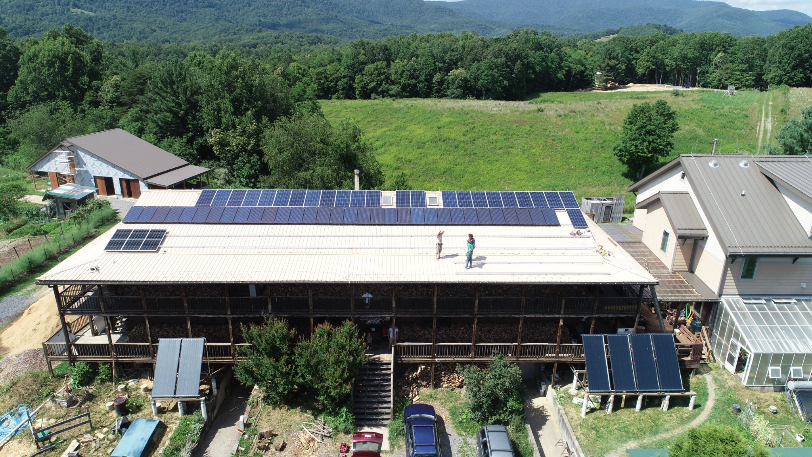
Economic Justice
The economy must serve people, not the other way around. All workers have a right to productive work, to decent and fair wages, to safe working conditions, and to join unions. No one should be allowed to amass excessive wealth when others lack the basic necessities of life.

Slide 46
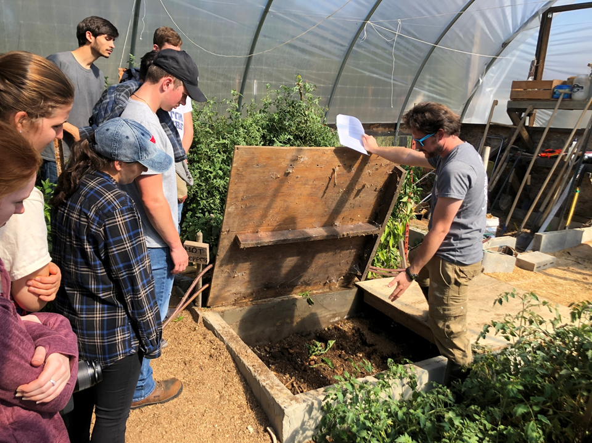
Common Good
The human person is both sacred and social. We realize our dignity and rights in relationship with others, in community. Human beings grow and achieve fulfillment in community. Human dignity can only be realized and protected in the context of relationship with the wider society.

Slide 47
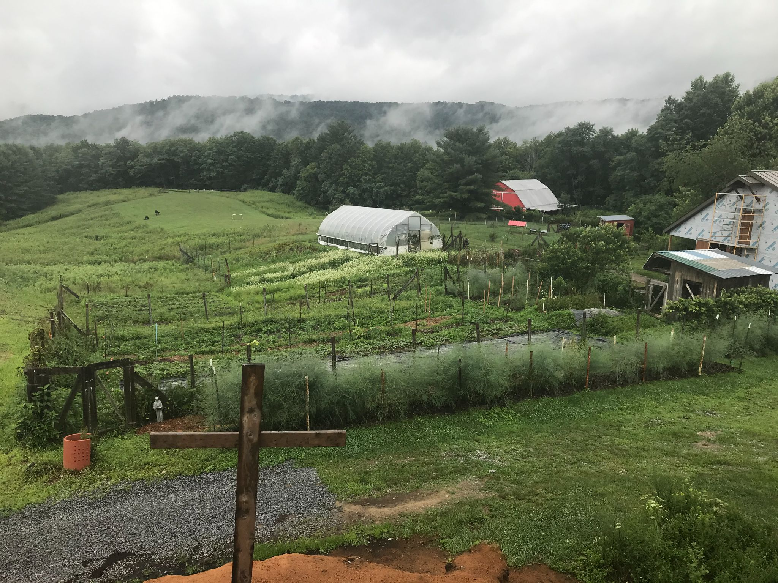
Life and Dignity of the Human Person
The inherent dignity of the human person is the foundation of all Catholic social teaching. Human life is sacred, and the dignity of the human person is the starting point for a moral vision for society. This principle is grounded in the idea that each person is made in the image of God. Our dignity does not come from what we have or what we do; it comes from God. We don’t need excess material goods to achieve self-worth; similarly, people’s actions or situations do not change their worth.

Slide 48
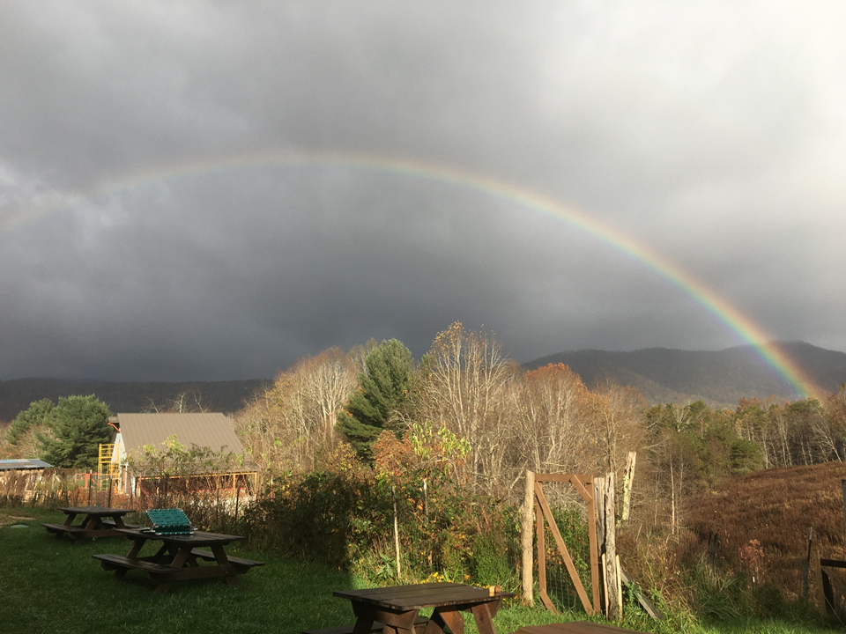
Time
Talent
Treasure
How are you responding to your call to care for creation?
Ideas: volunteer locally, observe a weekly electricity fast, come visit the farm!
Where are you situated to make change in your community?
Ideas: volunteer to lead a Laudato Si’ book club, teach your family about CST, encourage your place of work or parish to go solar
How do you steward your resources?
Ideas: begin with one food to only buy organic or local, include environmental organizations in your charitable giving

Slide 49
Catholic Sustainability Champions
Questions ?

Slide 50
Catholic Sustainability Champions
For more information:
info@CatholicClimateCovenant.org
and
www.CatholicClimateCovenant.org

